Slide 1


welcome to
week 6

Slide 2
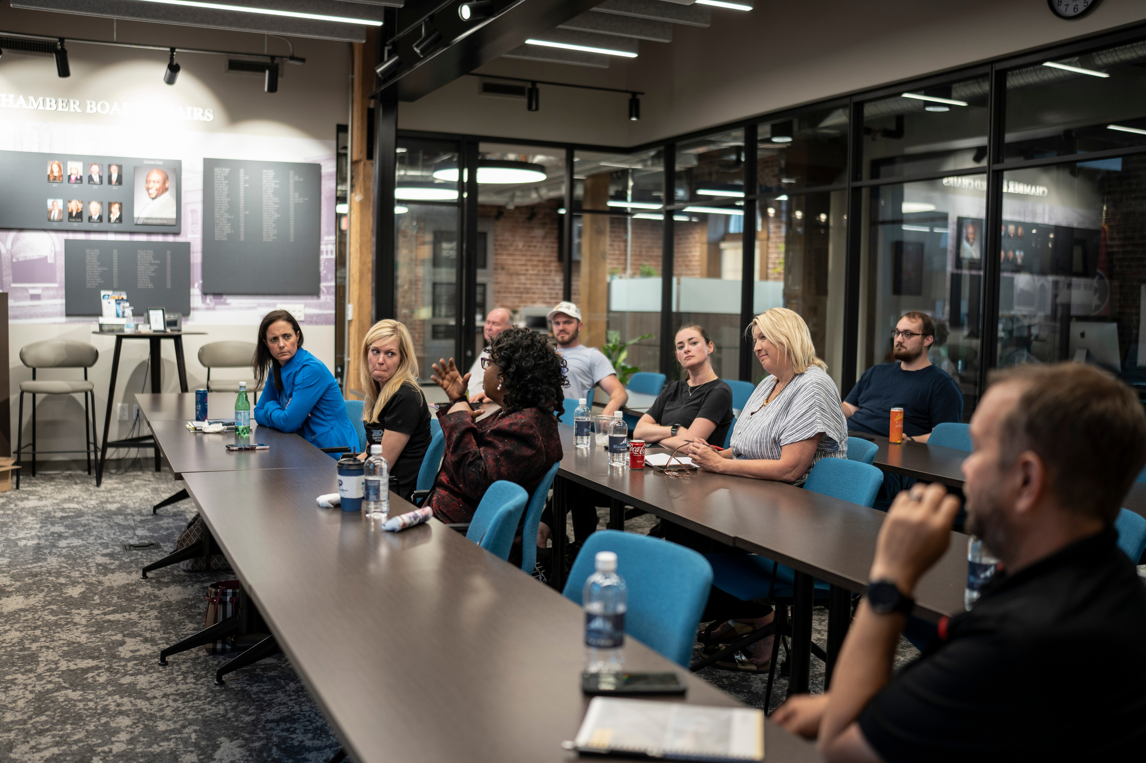

marketing your business
We’ll cover topics such as brand building, developing your brand voice, and exploring different marketing channels.

Slide 3
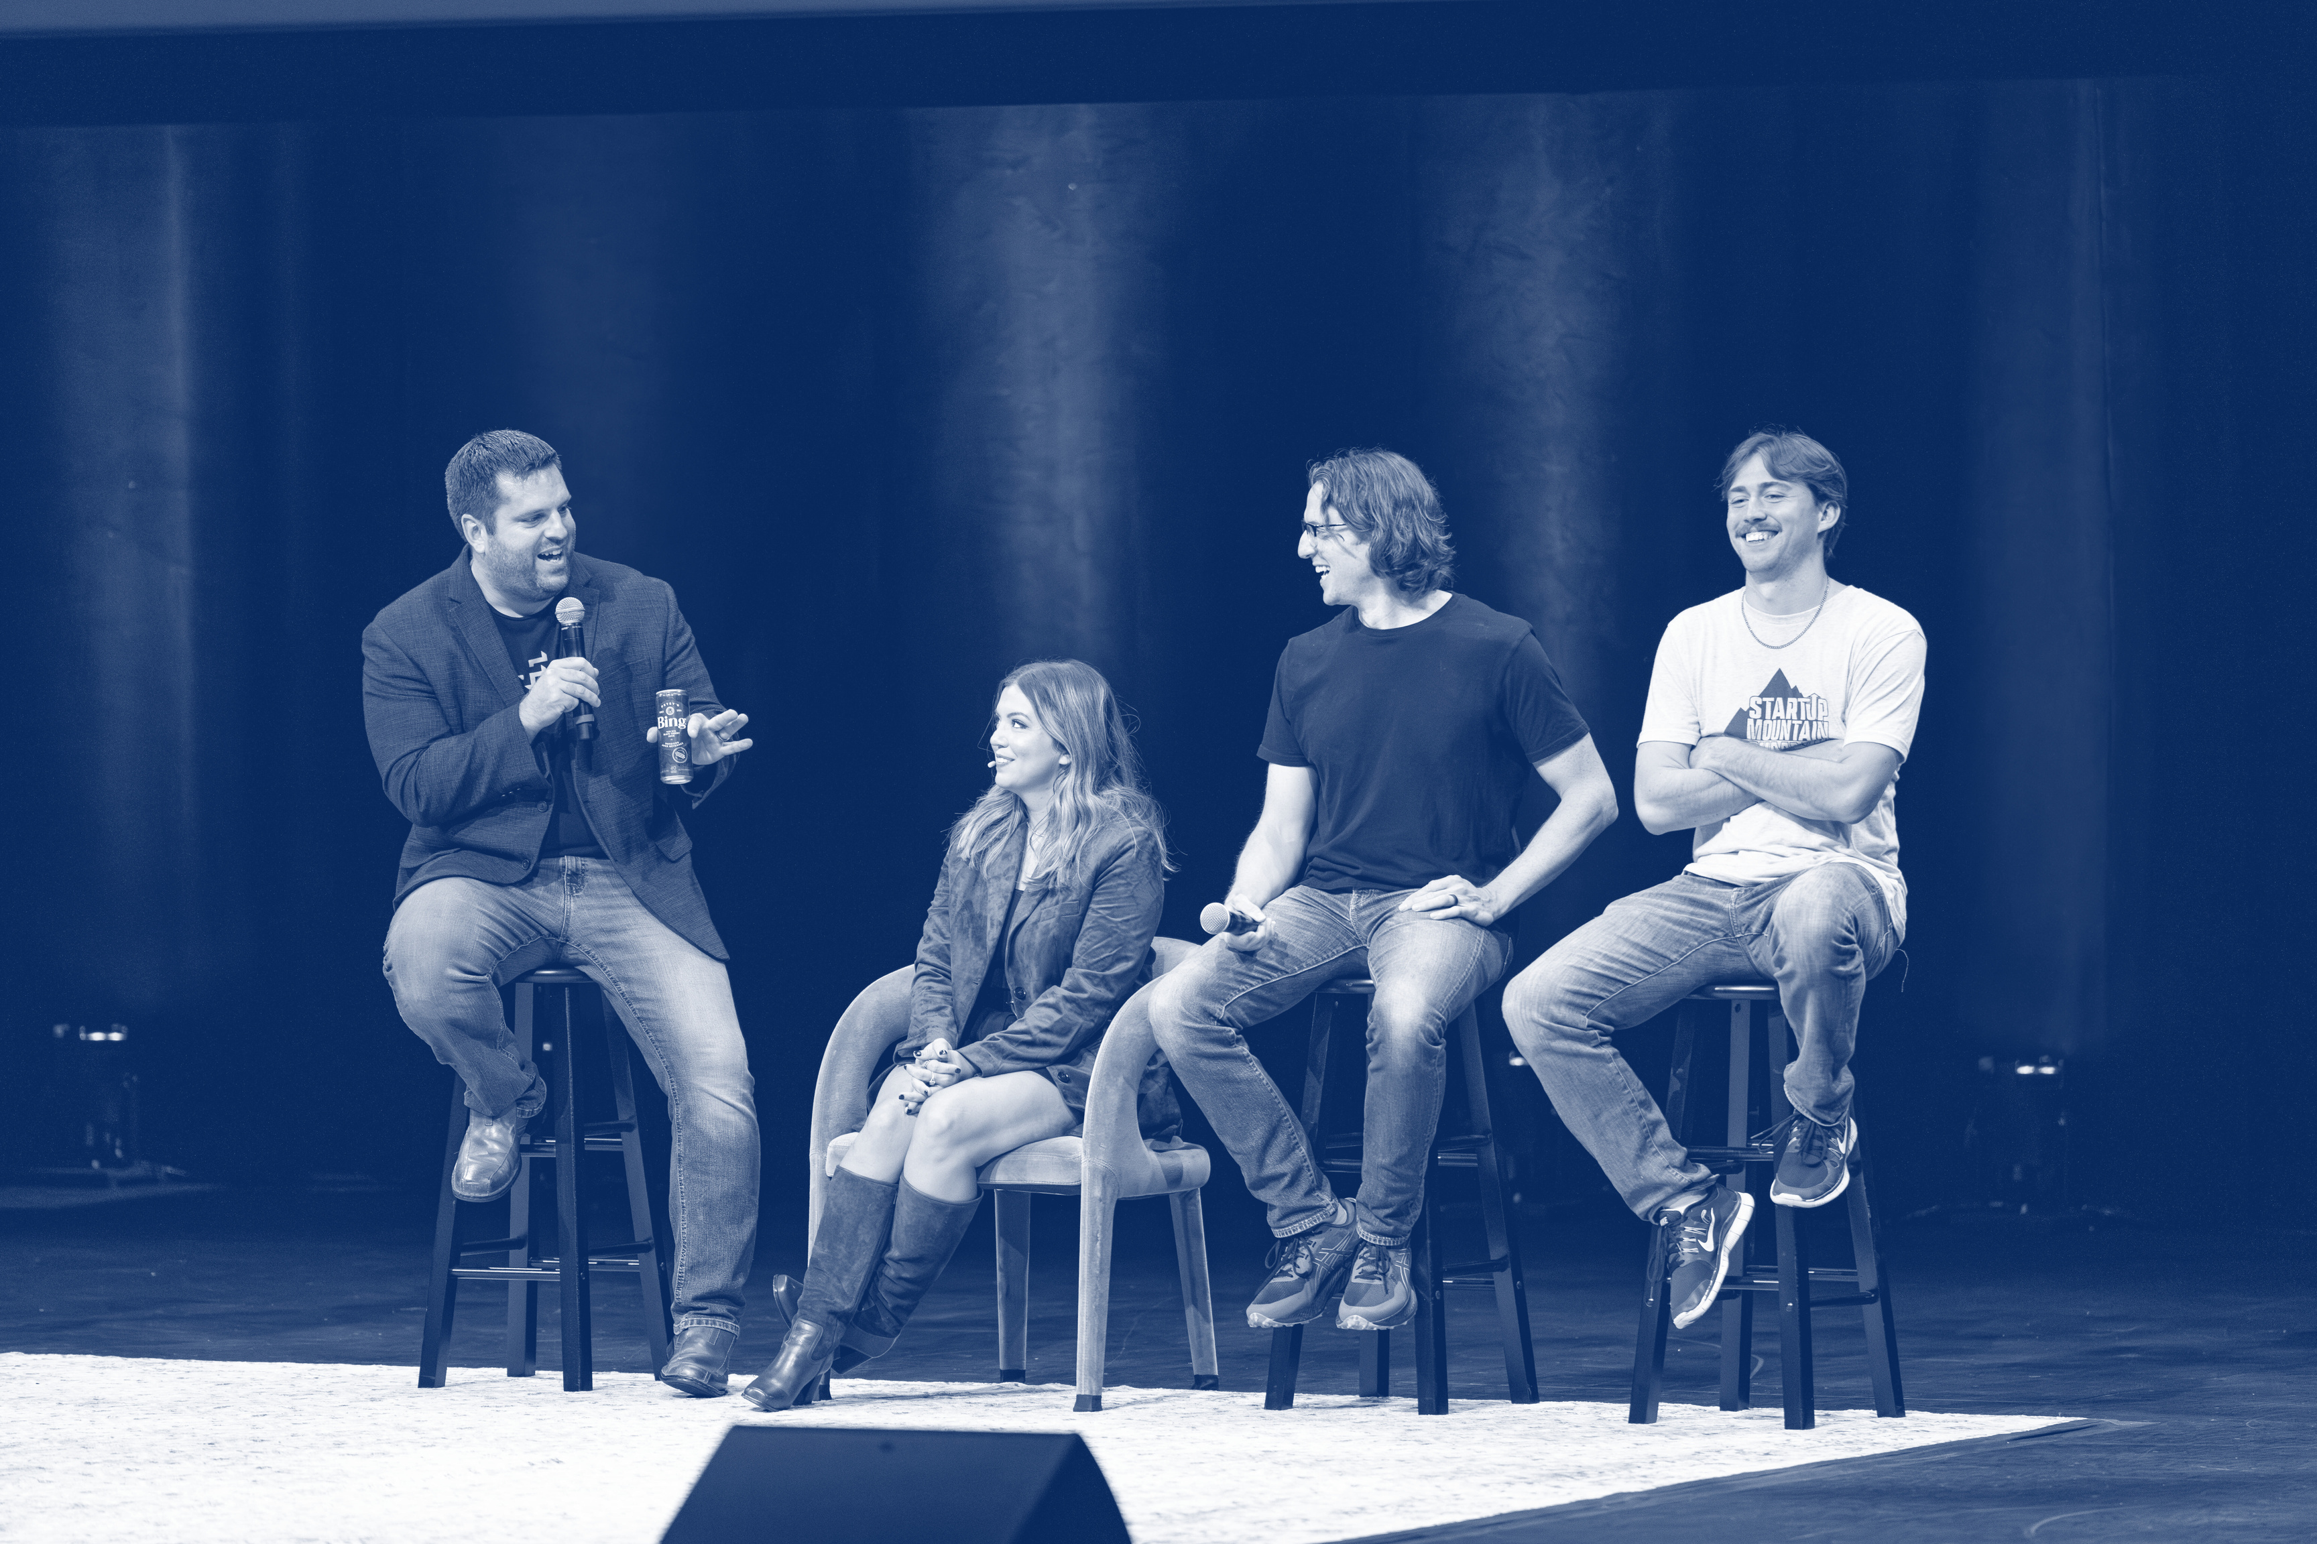
speaker session

Slide 4
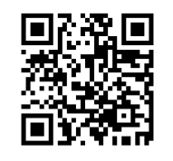
Feedback Survey Time
Before you leave class today, please fill out the survey. Your input helps us improve the program and help future founders.

Slide 5
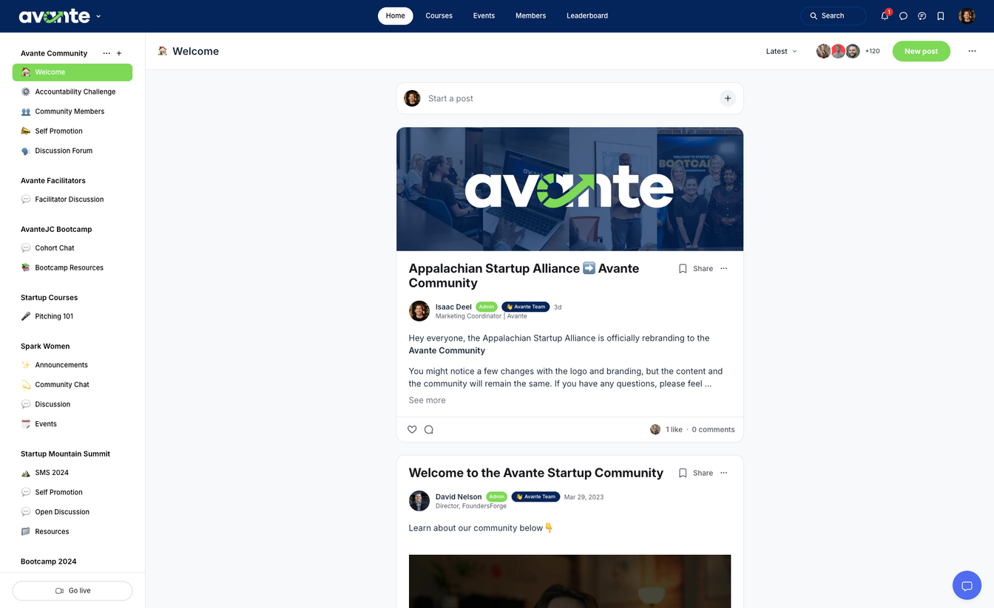

community
Stay updated with your
cohort & facilitator
Learn, connect, and engage with members
Access resources
*scan QR codes in book for access

Slide 6
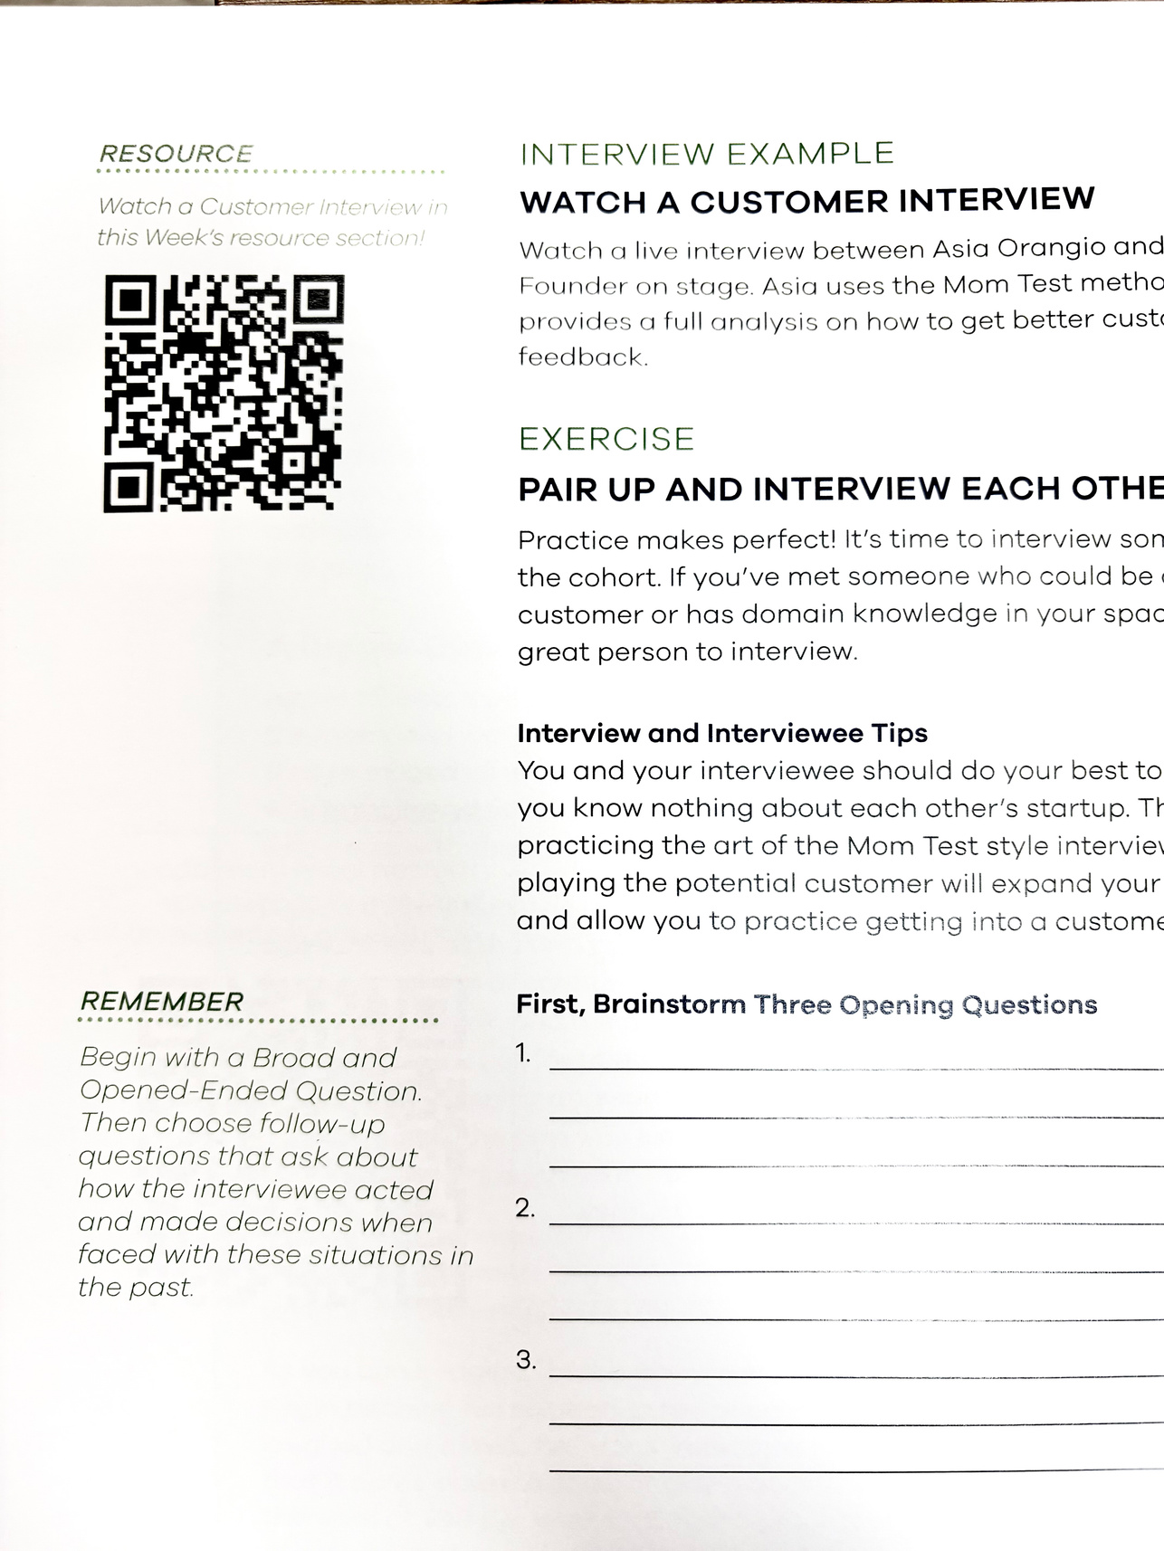
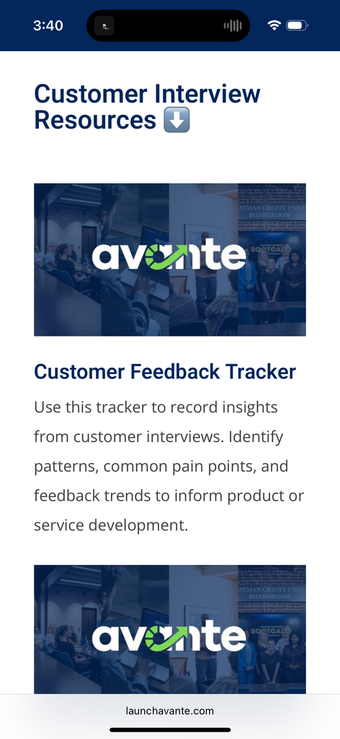
resource library
access chapter resources, interviews, and homework using the QR codes in your avante workbook.
scan

Slide 7
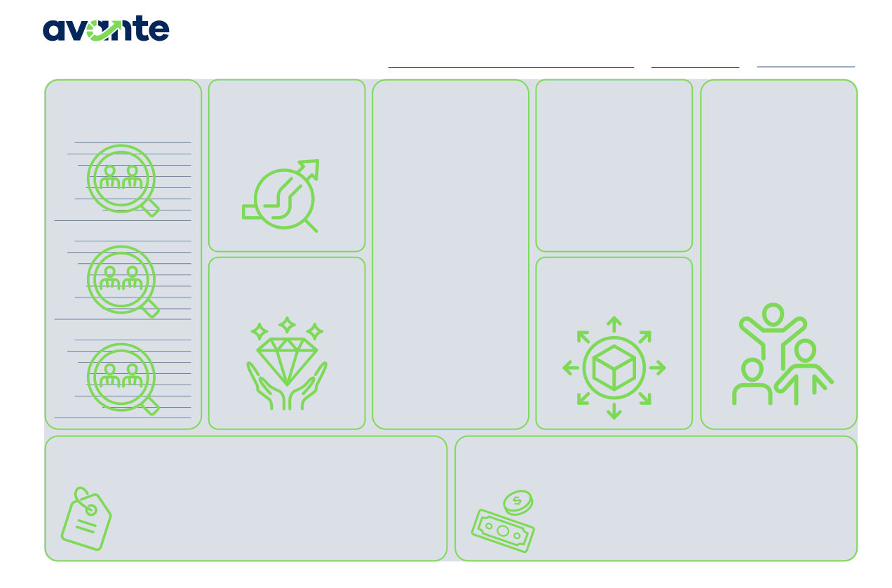
business model canvas
Continue to fill out your business model canvas each week.
Business Model Canvas
PROBLEM BEING
Startup Name
Date
Version
CUSTOMERS
List at least 3 of your customer personas or categories of customers
SOLUTION
ALTERNATIVES
How is the customer currently solving the problem? If competition exists, list them in this section.
NETWORK OF
SOLVED
List the problem being solved for your customers. This should be a short and succinct description of the problem.
Describe your Startup’s offering. This should directly solve the problem
SUPPORT
Who in your network will support your business’ success? (i.e. your local Amplify program, SBDCs, local main street program, local entrepreneur centers, friends, family, etc.)
Name Age Gender Pain Points Behaviors Goals How to interact
described.
Name Age Gender Pain Points Behaviors Goals How to interact
VALUE PROVIDED
What is the value to the customer? What do they gain by solving the problem?
DISTRIBUTION
What is the distribution model of the business and what channels exist to get your products to the customer?
Name Age Gender Pain Points Behaviors Goals How to interact
STARTUP COSTS
List the costs or categories of costs your business will require. Don’t forget to include the Founders time!
PRICING STRATEGY AND REVENUE STREAMS
List the primary and alternative pricing strategies. Then list the expected revenue streams for your business.
© 2025 FoundersForge | All Rights Reserved.
The Avante Canvas is adapted from the Business Model Canvas by Strategyzer.com and is licensed under the Creative Commons Attribution Share-Alike 3.0 Unported License.
*scan QR codes in book for digital version

Slide 8

share:
victories & roadblocks
Any wins or obstacles you’d like to share with the cohort?
ex. found a problem with my business model

Slide 9
share:
homework review
Did you build any projections?
Did you find a break-even point for your business?
Did you talk to new customers?

Slide 10
“People don’t buy what you do. They buy why you do it.”
- Simon Sinek

Slide 11
marketing (the fun one)

Slide 12

the marketing myth
Your product won’t market itself. Building the best product or service is not enough to succeed–people need to know about it too.

Slide 13
marketing is different than selling
Instead of focusing on pushing their products, Founders must focus on truly understanding their customers’ ⬇️
attitudes
behaviors
problems
current solutions

Slide 14
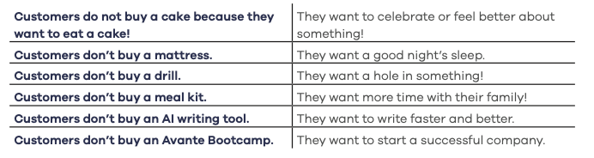
marketing is deeper than making a purchase
Your customers are seeking a change, an outcome, or a transformation, not just a product.

Slide 15
make your customer the hero
Oftentimes, Founders position their products as the hero in the story. However, if you don’t have customers, your product is worthless.
The customer is the hero. Your product is the guide that helps the customer succeed.

Slide 16
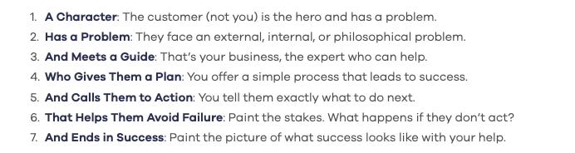
the hero’s journey
Donald Miller takes the heart of the Hero’s Journey and turns it into a simple, useful framework for business storytelling.
This framework is used in many movies and books

Slide 17
the goal of SB7
The goal of the SB7 framework is to put yourself in your customer’s shoes, position your product, and create a story that resonates with your target customer.

Slide 18



channels vs. tactics
Channels
Tactics
Channels are the different paths or platforms businesses use to reach their target audience.
Tactics are the specific actions or
strategies you use within a channel.
Improving website speed
Creating content for social media
Running paid ad campaigns

Slide 19
marketing channels (overwhelmed yet?)
content marketing
social media & ads
email marketing
search engine optimization
Influencers
publicity
community
building
speaking engagements
offline events
business development
sales
unconventio-nal PR
exisiting platforms
affiliate programs
search-engine-marketing
engineering as marketing
trade shows
offline ads

Slide 20

What is the right channel?
Every business has different customers with different behaviors, needs, and preferences. Therefore, the right channel depends on where your audience is easiest to reach.

Slide 21
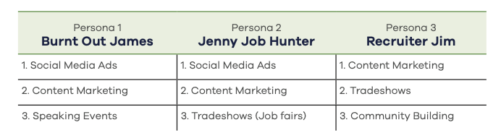
How to find your channels:
Revisit your customer personas (Chapter 2)
List 3 possible marketing channels for each persona.

Slide 22
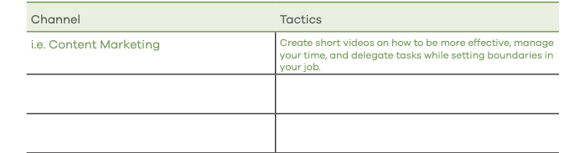
How to find your channels:
Lastly, brainstorm a few tactics to reach your personas on each channel.

Slide 23
how to test channels:
The goal is to verify whether a tactic and channel are likely to work before you invest a lot
of time or money. Focus on designing small, low-cost tests that can help prove the value of a channel.
ex. Posting 3-5 blog articles on your site and analyzing results

Slide 24
advice
knowing when to say no
Everyone wants a piece of your marketing budget (sponsorships, newspaper ads, etc.)
Don’t let pressure override your priorities. Be generous, but on your terms and timeline. Work on the channels that you feel are essential to your business. Let go of the rest.

Slide 25
building your brand
A strong brand helps people remember your
company and builds the trust needed for customers to feel confident buying from you.
Remember, your brand should resonate with your customers, not just you.

Slide 26
brand vs. brand voice
A brand brings together the reason the company exists, its core values, and the visuals that make customers feel a certain way when they interact with the business.
Brand voice is how the company
speaks, behaves, and connects with its audience.

Slide 27
your brand’s core
Why Does This Startup Exist?
What Does Your Company Believe In?
Who Are You Helping?
How Do You Want Your Customers to Feel When Interacting With Your Brand?

Slide 28
craft your brand voice
Is Your Brand Serious or Fun?
Describe Your Brand as a Person.
Our Brand’s Personality Strives to Always be:
When Interacting with Our Brand, Customers Should Feel:

Slide 29
creating a logo
You don’t have to have it all figured out. You don’t have to have the perfect logo, design, or colors in the beginning–you just need somewhere to start.
use canva
hire a designer
use 99 designs
use fiverr
use ai

Slide 30
creating a website
Unless you need custom software, use a website template builder for your business ⬇️
Dreamsite Builder
wix
square.space
wordpress
shopify (for e-commerce)

Slide 31
addressing social media
Social media is crucial for marketing your business.
Instagram
Bluesky
Twitter (x)
Find where your audience lives and start creating.
Facebook
Linkedin
TikTok

Slide 32
what not to do on social media:
Too often, businesses simply post their products on social media with a direct request to buy.
Imagine walking into a mall where every store vendor is shouting at you to purchase their
products, it would get annoying fast!

Slide 33
posting is not a strategy
jab, jab, jab, right hook is
The idea is to offer “jabs”, valuable or helpful social media content that builds trust and engages your audience, before delivering a clear, straightforward call to action, the “right hook.”

Slide 34
jab vs right hook examples
jab
right hook
Helpful, entertaining, or inspiring pieces of content you share with your audience.
Content with CTA’s. Phrases like “Buy this,” “Sign up now,” or “Check out our new product” clearly state what you want your followers to do.

Slide 35
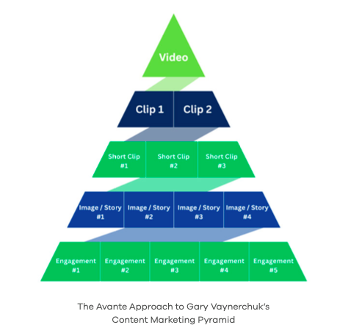
the content pyramid
Creating content takes energy and time. Find ways to repurpose your content and make the most of each piece.

Slide 36
the avante content process
Record a video interview
Break the video up into clips for social media
Break the Clips into images, stories, and quotes
1
2
3
Create captions from transcript of clips
Create blog posts
Schedule them to post
4
5
6

Slide 37
consistency
One of the biggest factors in marketing is consistency
Research has shown that posting on a regular schedule is critical for building a strong following. Posting sporadically, or “whenever you can,” will not help your business grow.

Slide 38
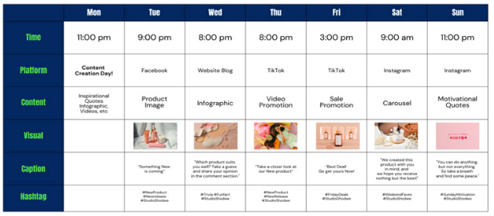
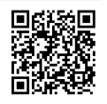
how to stay consistent
One of the most helpful tools for planning and sticking to a consistent social media strategy
is a Social Media Calendar.
grab ours ⬇️

Slide 39

advertising comparison
social media
advertising
traditional advertising
Ability to run small tests
Control over cost
Easy to see analytics
High attribution
Highly targeted
Time and energy
(billboards, newspaper, etc.)
Can be expensive
Low attribution
Less control

Slide 40
ai in marketing
AI helps founders be more efficient marketers. With AI you can clip videos, create better content, and automate simple marketing tasks.
However, AI isn’t a perfect tool, and Founders must continue to review and refine what AI creates. Sometimes AI generated content can feel impersonal or unclear... so be cautious

Slide 41
Feedback Survey Time
Before you leave class today, please fill out the survey. Your input helps us improve the program and help future founders.

