Slide 1


welcome to
week 5

Slide 2


business financials & funding your startup
We’ll focus on the importance of understanding your business finances and what key metrics to measure your company by.

Slide 3

speaker session

Slide 4
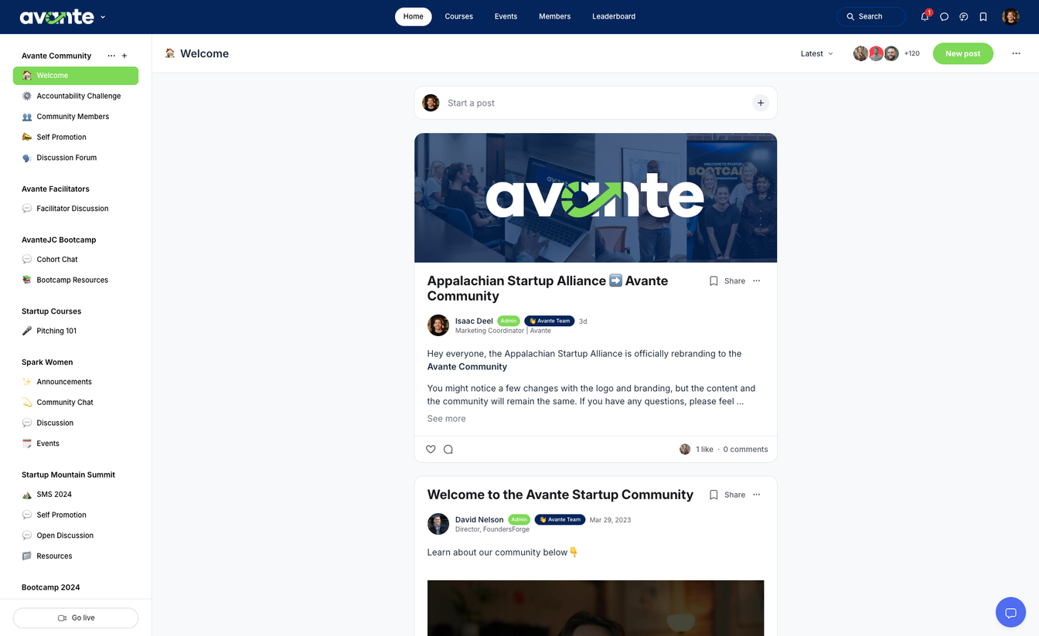

community
Stay updated with your
cohort & facilitator
Learn, connect, and engage with members
Access resources
*scan QR codes in book for access

Slide 5
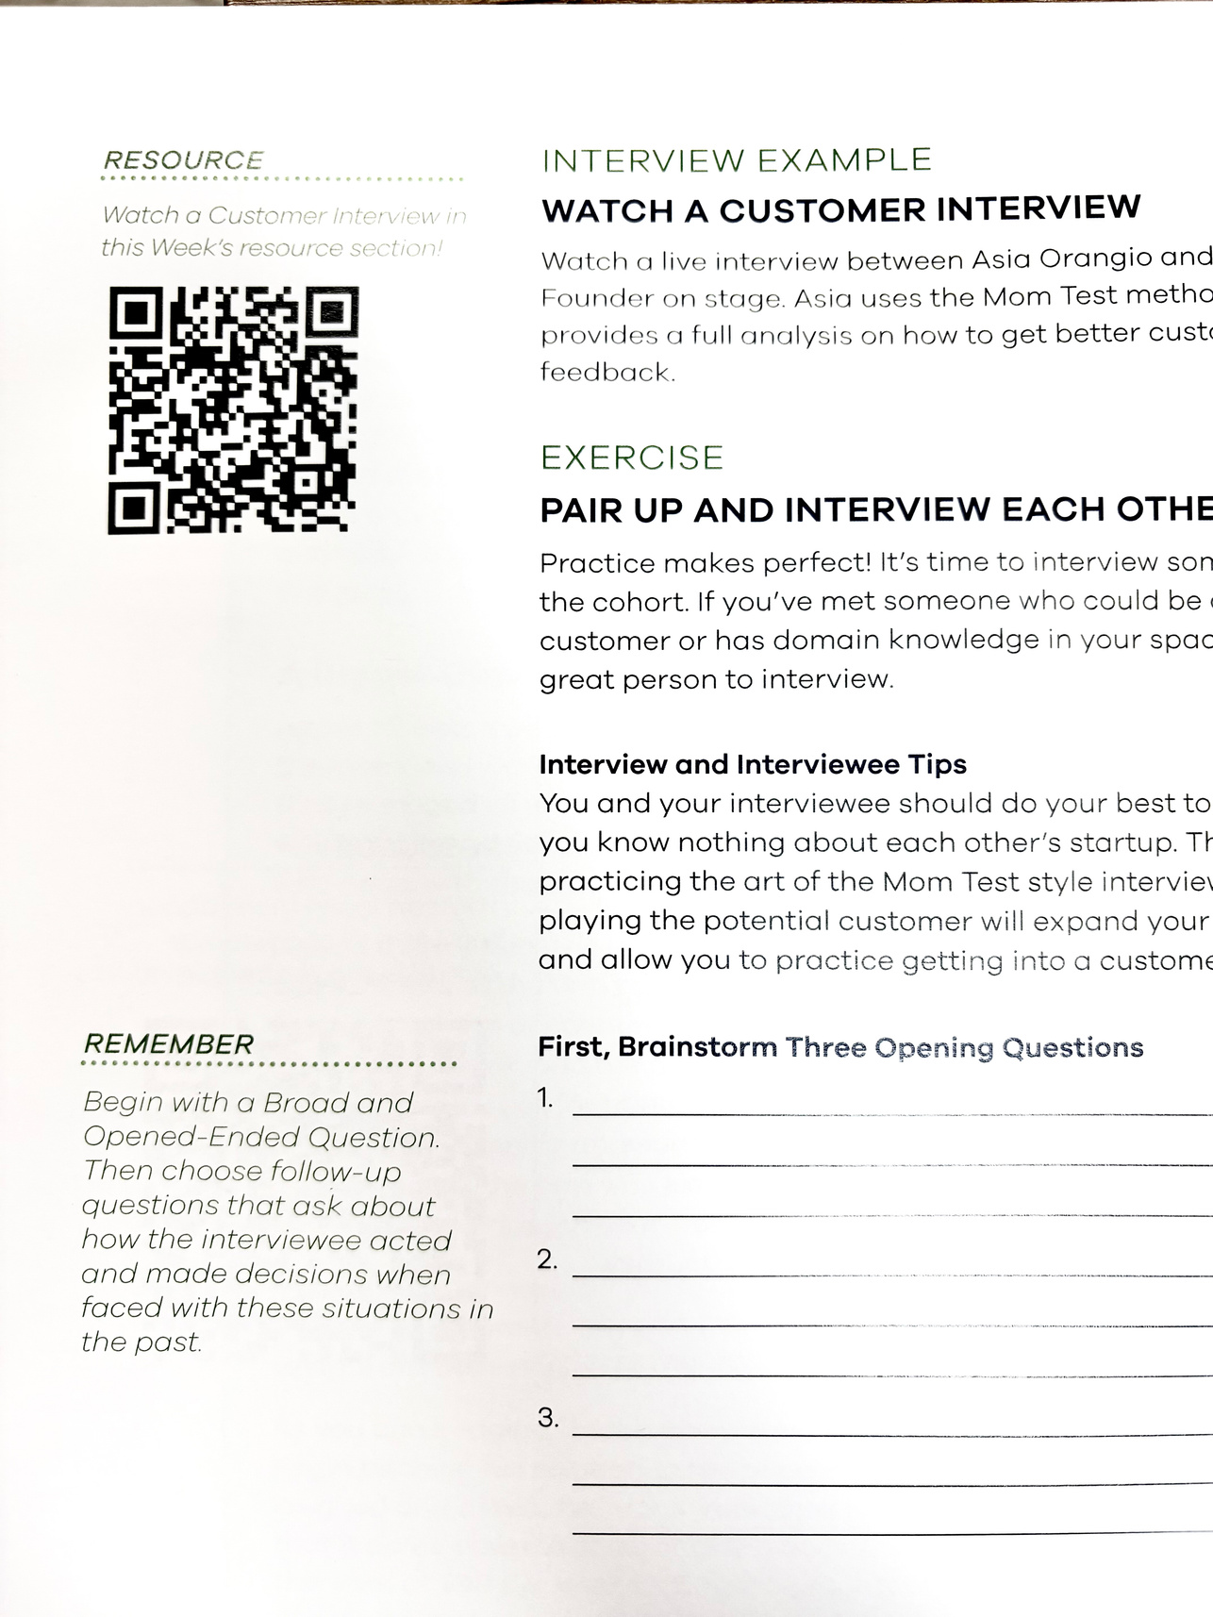
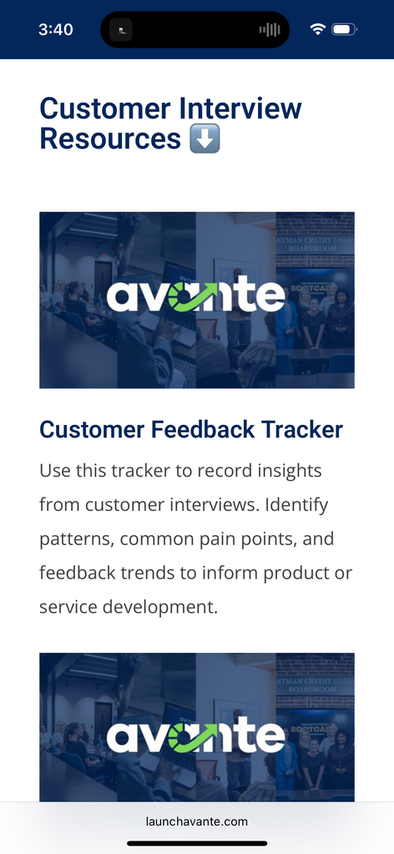
resource library
access chapter resources, interviews, and homework using the QR codes in your avante workbook.
scan

Slide 6
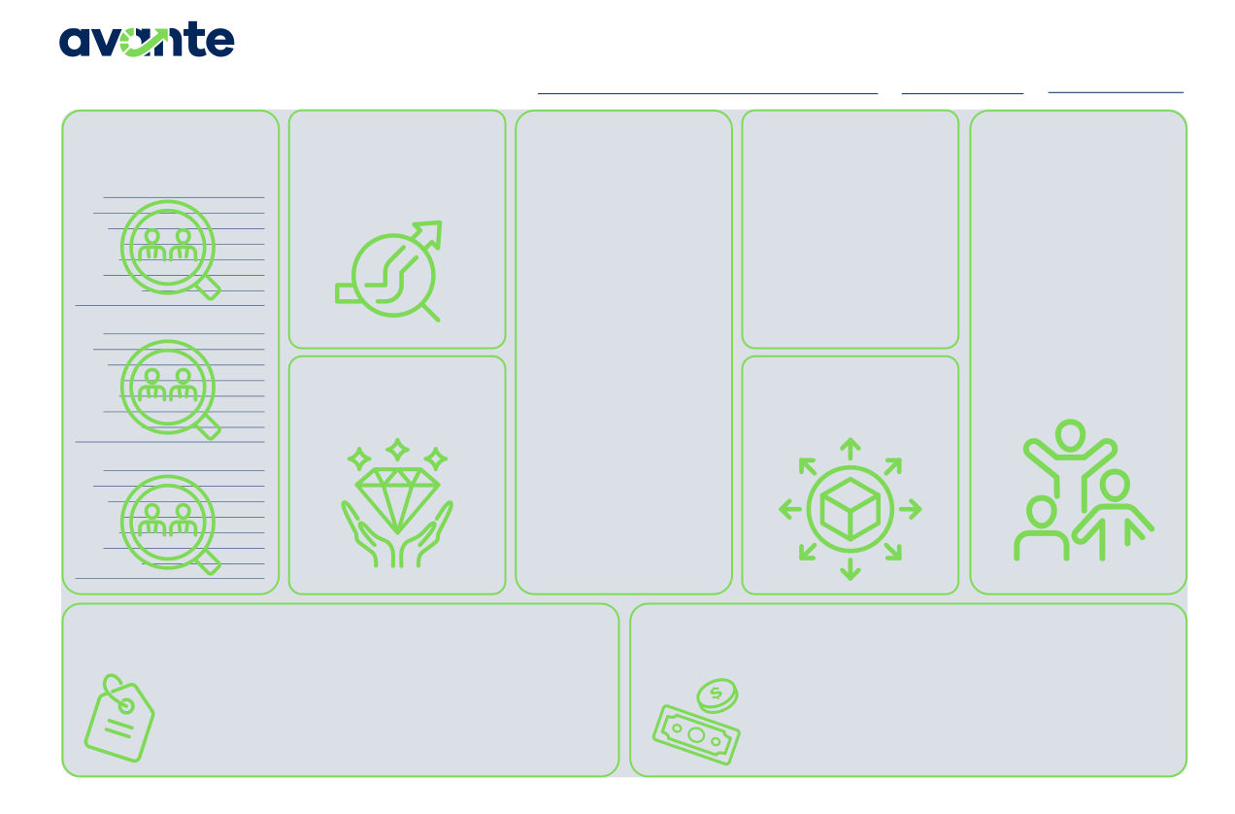
business model canvas
Continue to fill out your business model canvas each week.
Business Model Canvas
PROBLEM BEING
Startup Name
Date
Version
CUSTOMERS
List at least 3 of your customer personas or categories of customers
SOLUTION
ALTERNATIVES
How is the customer currently solving the problem? If competition exists, list them in this section.
NETWORK OF
SOLVED
List the problem being solved for your customers. This should be a short and succinct description of the problem.
Describe your Startup’s offering. This should directly solve the problem
SUPPORT
Who in your network will support your business’ success? (i.e. your local Amplify program, SBDCs, local main street program, local entrepreneur centers, friends, family, etc.)
Name Age Gender Pain Points Behaviors Goals How to interact
described.
Name Age Gender Pain Points Behaviors Goals How to interact
VALUE PROVIDED
What is the value to the customer? What do they gain by solving the problem?
DISTRIBUTION
What is the distribution model of the business and what channels exist to get your products to the customer?
Name Age Gender Pain Points Behaviors Goals How to interact
STARTUP COSTS
List the costs or categories of costs your business will require. Don’t forget to include the Founders time!
PRICING STRATEGY AND REVENUE STREAMS
List the primary and alternative pricing strategies. Then list the expected revenue streams for your business.
© 2025 FoundersForge | All Rights Reserved.
The Avante Canvas is adapted from the Business Model Canvas by Strategyzer.com and is licensed under the Creative Commons Attribution Share-Alike 3.0 Unported License.
*scan QR codes in book for digital version

Slide 7

share:
victories & roadblocks
Any wins or obstacles you’d like to share with the cohort?
ex. found a problem with my business model

Slide 8
share:
homework review
Did anyone make changes to their business structure?
Did anyone file for their business license?
Did you talk to new customers?

Slide 9
“If you don’t know your numbers, you don’t know your business.”
-Marcus Lemonis | CEO of Camping World

Slide 10
startup financials

Slide 11
the reality of finances
Ignoring your numbers is like driving cross-country without a map. You might end up somewhere, but there’s a good chance you’ll take a wrong turn or run out of gas before
reaching your destination.

Slide 12
continued...
Financials can be overwhelming at first, but they are critical to your business’s survival.
We’ll start with the basics: P&L, Balance Sheet, and cash flow statement.

Slide 13
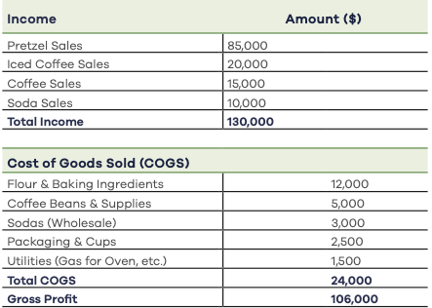
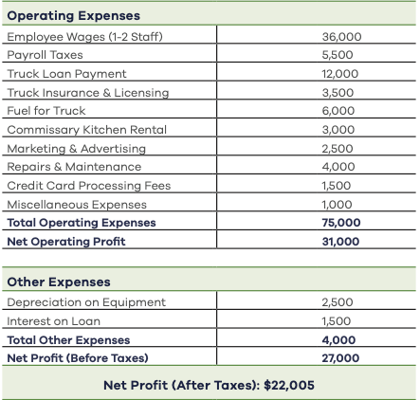

profit and loss statement (P&L)

Slide 14

things to consider
If the net profit is positive, the business is making money.
If it is negative, then it is losing
money, and the Founder needs to address costs.

Slide 15
cogs & operating expenses
These metrics help founders fully understand the costs of running a business. If a business isn’t profitable—it’s time to adjust pricing or reduce costs/expenses.

Slide 16
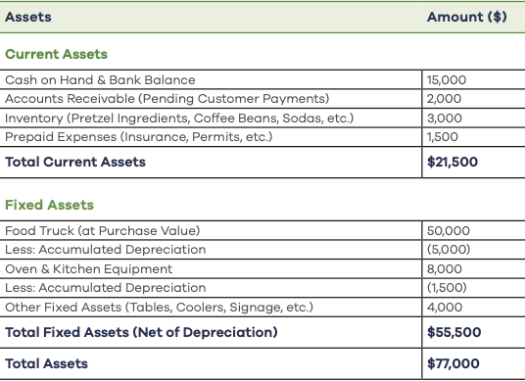
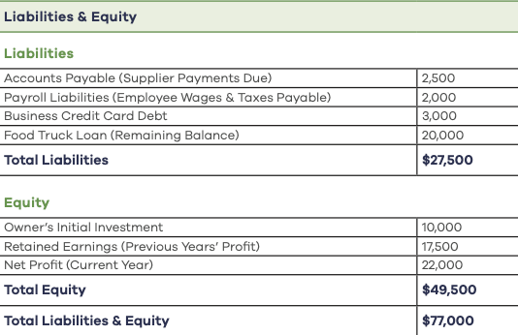

understanding the balance sheet
these should be balanced

Slide 17
balance sheet terms
Current Asset: The short-term resources that can be turned into cash within a year.
Fixed Assets: These are long-term investments the business needs to operate.
Business liabilities: financial obligations that a business must pay, either in short or long term.
Equity: The ownership value of a business after liabilities are deducted from assets.

Slide 18
balance sheet
A Balance Sheet follows a simple accounting equation: Assets = Liabilities + Equity
This equation ensures that everything that a business owns (assets) is either:
1. Funded by borrowing money (liabilities) or
2. Funded by the owner’s or investor’s money (equity)

Slide 19
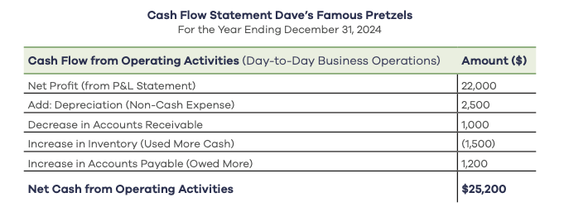
cash flow statement

Slide 20
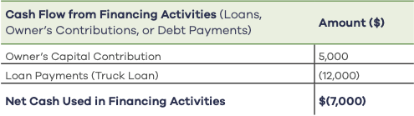
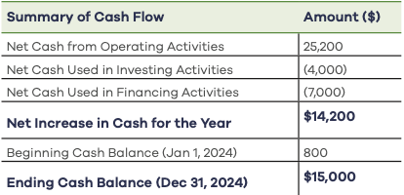
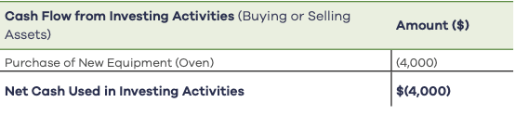

investing & financing activities
summary

Slide 21
why cash flow matters
If a business has positive operating cash flow, it likely has a healthy foundation.
If a business has a consistently negative operating cash flow, it likely will struggle to survive.

Slide 22
share
what questions do you have?
Were the financial reports as hard to understand as first expected?
Before reading this, were the business financials as important to you as they should be?

Slide 23
break-even analysis
What is it?
A Break-Even Analysis is a financial calculation that determines the point at which a business’s revenue equals its total costs.

Slide 24
how to build a break-even analysis
Identify your fixed costs. Ex. rent, salaries
2. Determine variable costs. Ex. labor, ingredients
2. Set your selling price. Ex. low, medium, high

Slide 25

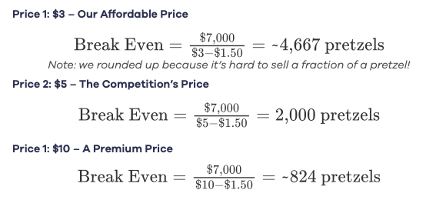
break even equation
at $3 a pretzel
I need to sell this many pretzels to break even
at $5 a pretzel
at $10 a pretzel

Slide 26
financial projections
The purpose of financial projections is
to provide a forward-looking financial plan that helps businesses make strategic decisions, secure funding, and plan for the future.

Slide 27
score projections
Avante recommends using the “score” projection template which is located in the chapter 5 resources. Scan the QR code in your book or navigate to the avante community resources sections to use it.

Slide 28
funding your startup
To secure funding, you first need to validate your idea, build a business around it, and then seek investment (if applicable).
Once you can show that your idea makes money and you’ve built a track record, funding becomes slightly easier to access.

Slide 29
funding continued...
Yes, small business grants do exist—but they can be difficult to find and are often restrictive.
Most venture capital is not suited for small businesses. Very few businesses receive investment.
Almost all loans, including SBA loans, require at least one Founder to sign a personal guarantee, meaning your personal assets are at risk.

Slide 30
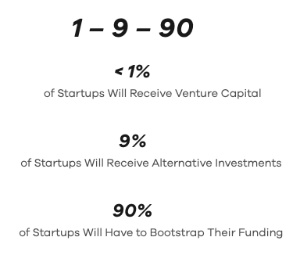
venture capital
Raising capital, applying for loans, and alternative funding methods can be a full-time job. First, make sure your business is validated before you go after money.

Slide 31
types of funding
Venture capital
Loans
Angel investors
Lines of credit
Strategic investors
Crowdfunding

Slide 32
what to avoid
Always avoid using credit cards or predatory loans to fund your business. Low or 0% interest rates may seem attractive at first, but these offers often come with hidden risks.
Using a credit card can quickly put a Founder in a tough spot, forced to choose between paying off the balance or keeping the business running.

Slide 33
what to avoid pt. 2
Always avoid using 401k or retirement savings to fund your business. Doing this is extremely risky to your personal financial security.
Always avoid inexperienced investors. The best investors offer their expertise and let the founder use their expertise.

Slide 34
case study:
the credit card story
Consider the Difference in Interest with a Credit
Credit Card (at a 24% APR) $30k x 24% = $7,200
Credit Card (at 30% Penalty APR) $30k x 30% =$9,000
SBA Loan (at 10% APR) $30k x 10% = $3,000
You Decide: What is More Affordable for a Startup to Pay Off?

Slide 35

homework
Update break-even point and build 3 year projections
Read chapter 6 and fill out workbook
Interview 3 new customers

