Slide 1


welcome to
week 4

Slide 2


build your company and your team
We’ll cover the different types of
companies, the incorporation process, how to seek legal help, and how to find the best people to join your team as you grow.

Slide 3

speaker session
(optional)
[Speaker Headshot, Name and Bio]

Slide 4
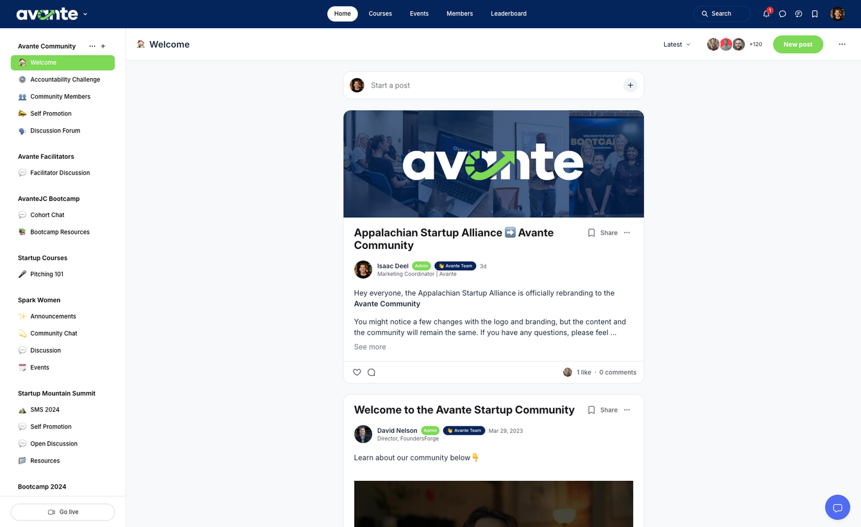

community
Stay updated with your
cohort & facilitator
Learn, connect, and engage with members
Access resources
*scan QR codes in book for access

Slide 5
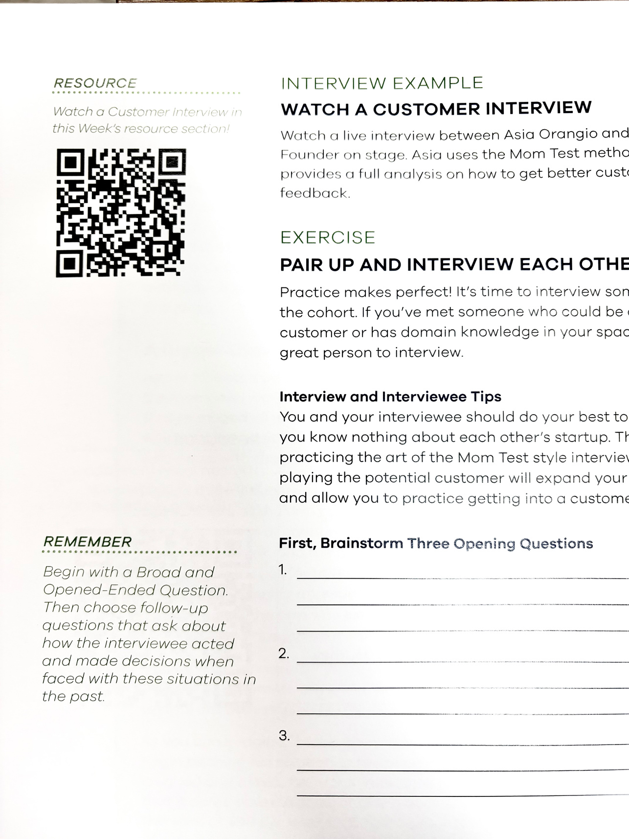
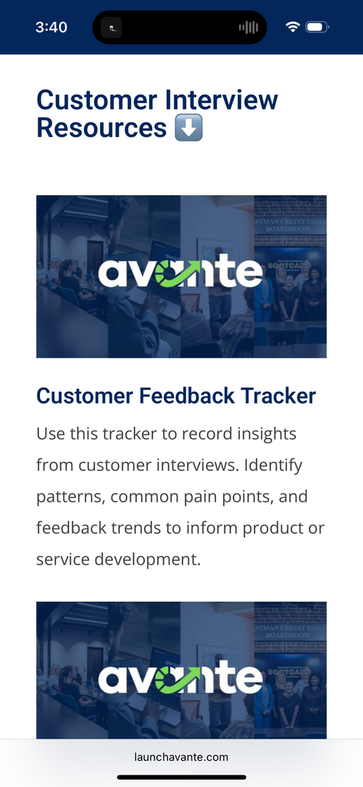
resource library
access chapter resources, interviews, and homework using the QR codes in your avante workbook.
scan

Slide 6
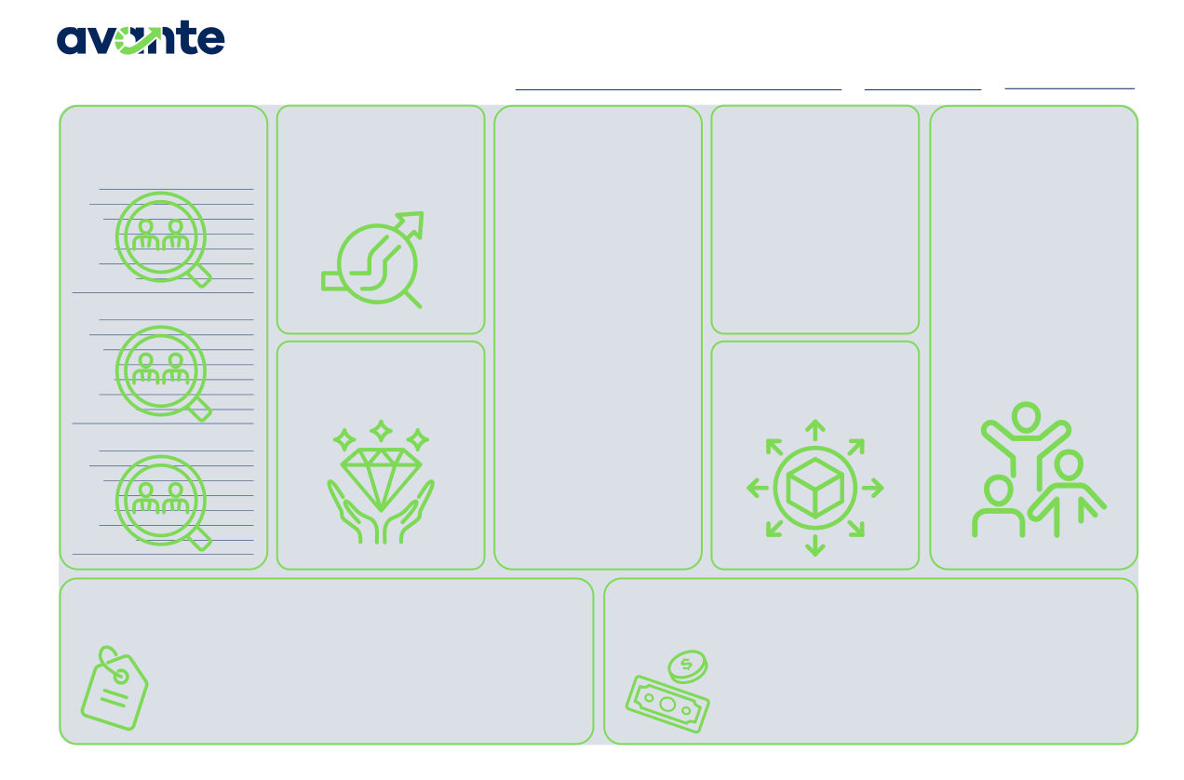
business model canvas
Continue to fill out your business model canvas each week.
Business Model Canvas
PROBLEM BEING
Startup Name
Date
Version
CUSTOMERS
List at least 3 of your customer personas or categories of customers
SOLUTION
ALTERNATIVES
How is the customer currently solving the problem? If competition exists, list them in this section.
NETWORK OF
SOLVED
List the problem being solved for your customers. This should be a short and succinct description of the problem.
Describe your Startup’s offering. This should directly solve the problem
SUPPORT
Who in your network will support your business’ success? (i.e. your local Amplify program, SBDCs, local main street program, local entrepreneur centers, friends, family, etc.)
Name Age Gender Pain Points Behaviors Goals How to interact
described.
Name Age Gender Pain Points Behaviors Goals How to interact
VALUE PROVIDED
What is the value to the customer? What do they gain by solving the problem?
DISTRIBUTION
What is the distribution model of the business and what channels exist to get your products to the customer?
Name Age Gender Pain Points Behaviors Goals How to interact
STARTUP COSTS
List the costs or categories of costs your business will require. Don’t forget to include the Founders time!
PRICING STRATEGY AND REVENUE STREAMS
List the primary and alternative pricing strategies. Then list the expected revenue streams for your business.
© 2025 FoundersForge | All Rights Reserved.
The Avante Canvas is adapted from the Business Model Canvas by Strategyzer.com and is licensed under the Creative Commons Attribution Share-Alike 3.0 Unported License.
*scan QR codes in book for digital version

Slide 7

share:
victories & roadblocks
Any wins or obstacles you’d like to share with the cohort?
ex. made my first dollar

Slide 8
share:
homework review
Any adjustments to your pricing model?
Did you talk to customers?
Did you rethink your distribution model?

Slide 9
“No matter how brilliant your mind or strategy, if you’re playing a solo game, you’ll always lose out to a team.”
-Reid Hoffman | Linkedin Co-Founder

Slide 10
business structures

Slide 11
for-profit vs non-profit
Choosing between a for-profit or nonprofit model shapes how your business makes money, who owns it, and what you're working toward.
**Both need revenue to survive

Slide 12
structuring your business
sole proprietorships
limited liability partnerships (LLP), limited partnership (LP), cooperatives
limited liability company (LLC)
b-corporations (B-Corp)
single member & multi-member LLCS
non-profits
s-corporations (s-corp)
low-profit limited liability company
llc with an s-corp election
c-corporations (c-corp)

Slide 13
sole proprietorship
A single person owns and operates the business. Easy and inexpensive but owner is personally liable for debts and obligations. Limited access to funding.

Slide 14
limited liability company (LLC)
Offers person liability protection for owners while allowing for simpler tax and management options. Higher setup costs and fees than sole proprietorships.

Slide 15
s-corporations (S-Corp)
A corporation that passes income, losses, and tax obligations through to its shareholders, avoiding double taxation. Strict eligibility requirements and operational formalities will occur.

Slide 16
c-corporations (C-Corp)
A standard corporation with profits taxed separately from its owners under corporate tax rules. It is the preferred structure for high-growth startups and includes attractive stock options for investors.

Slide 17
non-profit
Eligible for grants and tax-exempt donations, no profit distribution to owners, mission-driven, and board-managed.

Slide 18
case study:
know your requirements
Common Mistakes:
Using business funds for personal purchases without clear, documented purposes
Mixing finances between multiple businesses
Failing to document policies for company assets

Slide 19
when should you incorporate?
For some types of businesses, filing early is non-negotiable. If you are hiring employees, even on a part-time or contract basis, you should have a legal entity in place.
If you are still in the idea phase, testing a concept online, or freelancing with minimal interaction, you may choose to wait.

Slide 20
can you file yourself?
It depends on the business structure & how comfortable you are with the process. Some structures are simple to file like LLC’s and Sole-Proprietorships. Other, more complex types might require help or consultation.

Slide 21
share:
what is your structure?
Share your business structure with the cohort.
Help cohort members brainstorm possible structures.

Slide 22
trademark basics

Slide 23
trademarks
The trademark must be distinctive
It must be used (or intended to use)
in commerce
Must be unique to the industry
It must fall within a specific class
Must submit a proper application and be accepted.

Slide 24
solo-preneur or co-founder?
High growth startups pursuing venture capital will likely require a co-founder(s) and are .
Small businesses can be successful without a co-founder—sometimes a cofounder is not always a benefit.

Slide 25
building a team

Slide 26
picking the right people
“If you want to go fast, go alone. If you want to go far, build a team!”
Hire people that share your vision as a founder.

Slide 27
case study:
the generalist
Hiring the right team started with finding people that shared the same vision
Built a good company culture
Hiring a team allowed Brad and Lora to handle more important tasks and have flexibility.

Slide 28
solo-preneur or co-founder?
Founders should not find a Co-Founder just to have one—it’s similar to a marriage.
However, being able to share the burden of launching, growing, and exiting a business can be an incredible benefit to the Founders.

Slide 29
1099 vs W2
W2 employees are hired directly by a company, work under its control, and receive benefits like health insurance, paid time off, and employer tax contributions.
1099 workers are independent contractors who operate as self-employed
individuals, handling their own taxes and typically working on a project or short-term basis.

Slide 30
case study:
can’t afford benefits?
Hiring a full-time employee in the beginning can be expensive and come with state requirements
Offer a stipend for health care coverage or other insurance
Use contractors for short-term labor and projects

Slide 31
hiring
“Hire slow and fire quickly.”
Your early team is critical to the success of your business. Take time to hire people who share your vision, fit with your culture, and add value to your organization.

Slide 32
hiring continued
If you make a mistake or make a bad hire, take action quickly—the success of your business depends on it.
It is very rare to hear someone say, “I am glad I didn’t fire that person too soon!”
But we all have heard someone say, “I should have let them go sooner.”

Slide 33
case study:
the slack story
It matters how you let people go.
If you have to layoff or fire people, go above and beyond to make sure your company demonstrates empathy and care. Support former employees career growth, preserve their dignity, and help move them in the right direction.

Slide 34

homework
Incorporate your startup (optional)
use the checklists in this chapter to help
Read chapter 5 and fill out workbook
Interview 3 new customers sections

