Slide 1


welcome to
week 3

Slide 2
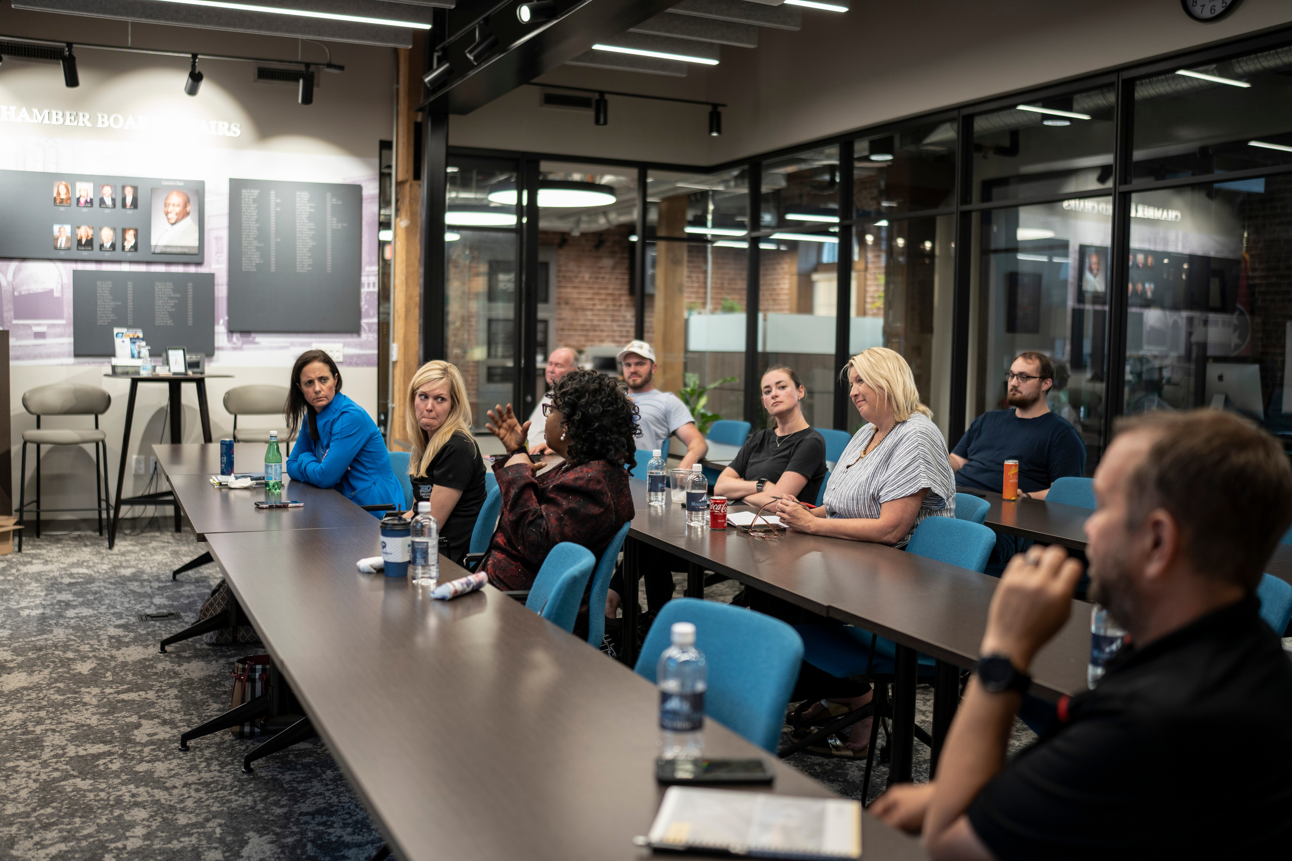

building a plan for
your business
learn about business models, distribution methods, and pricing for your business

Slide 3
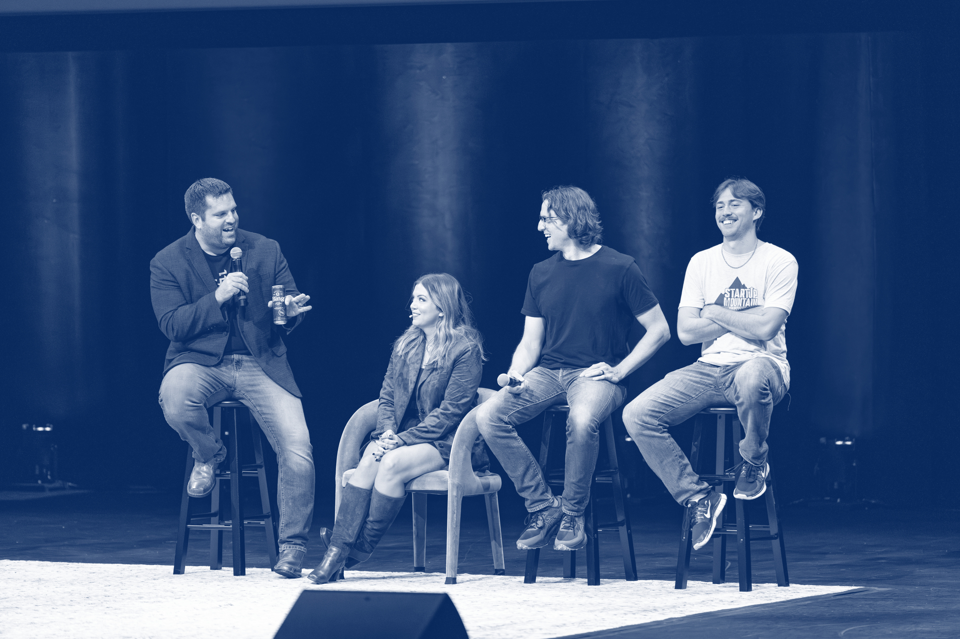
speaker session

Slide 4
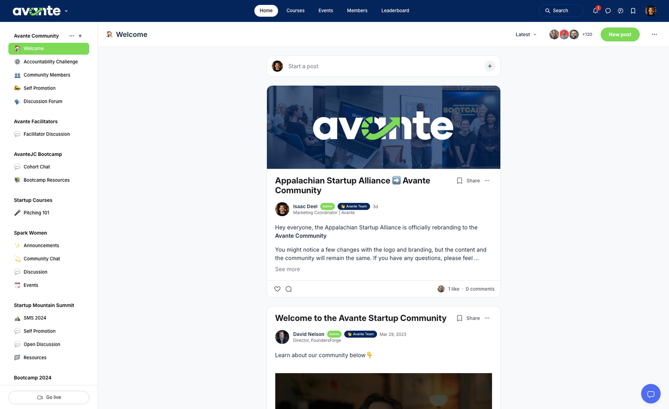

community
Stay updated with your
cohort & facilitator
Learn, connect, and engage with members
Access resources
*scan QR codes in book for access

Slide 5
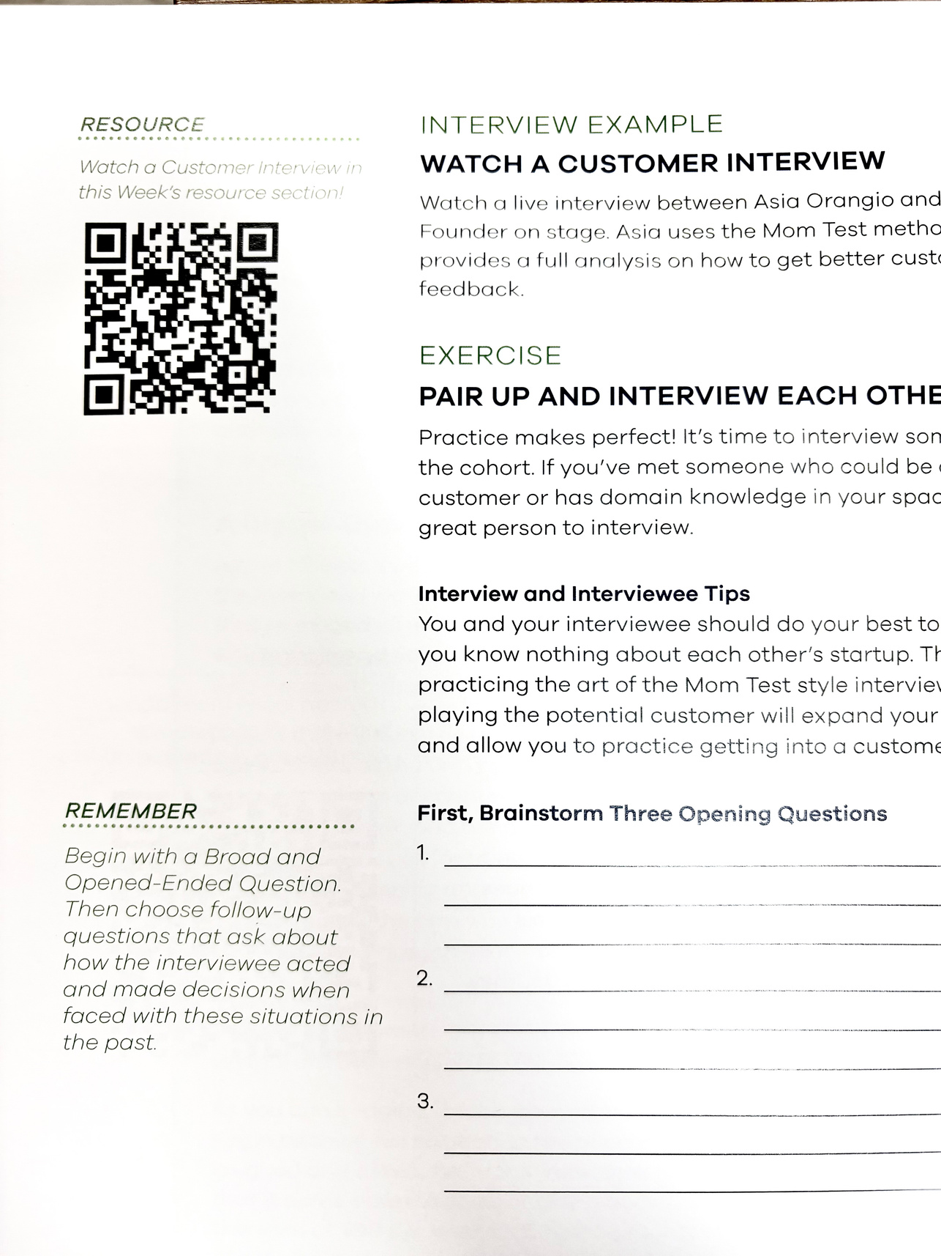
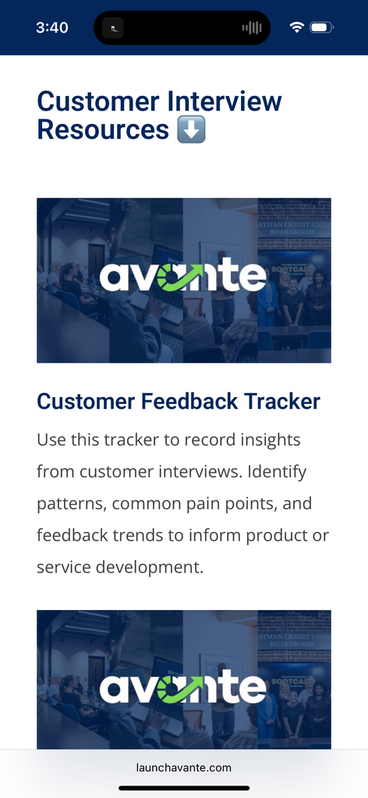
resource library
access chapter resources, interviews, and homework using the QR codes in your avante workbook.
scan

Slide 6
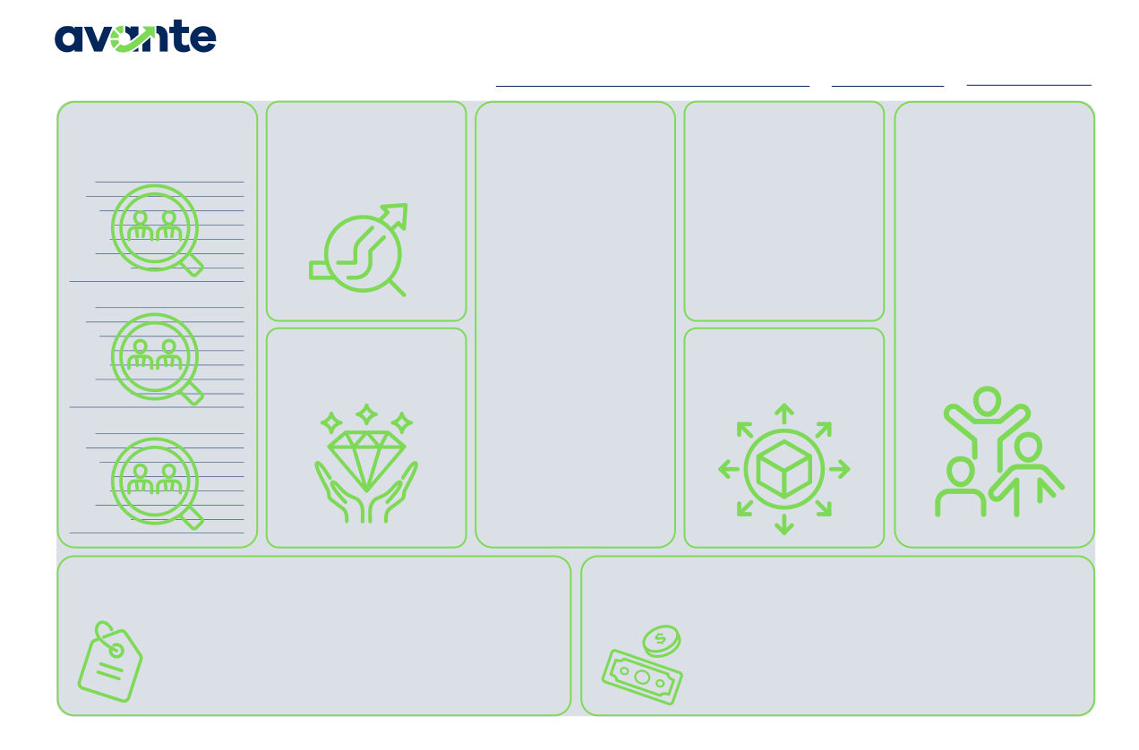
business model canvas
This week, we will fill in the distribution and pricing strategies section of the canvas.
Business Model Canvas
PROBLEM BEING
Startup Name
Date
Version
CUSTOMERS
List at least 3 of your customer personas or categories of customers
SOLUTION
ALTERNATIVES
How is the customer currently solving the problem? If competition exists, list them in this section.
NETWORK OF
SOLVED
List the problem being solved for your customers. This should be a short and succinct description of the problem.
Describe your Startup’s offering. This should directly solve the problem
SUPPORT
Who in your network will support your business’ success? (i.e. your local Amplify program, SBDCs, local main street program, local entrepreneur centers, friends, family, etc.)
Name Age Gender Pain Points Behaviors Goals How to interact
described.
Name Age Gender Pain Points Behaviors Goals How to interact
VALUE PROVIDED
What is the value to the customer? What do they gain by solving the problem?
DISTRIBUTION
What is the distribution model of the business and what channels exist to get your products to the customer?
Name Age Gender Pain Points Behaviors Goals How to interact
STARTUP COSTS
List the costs or categories of costs your business will require. Don’t forget to include the Founders time!
PRICING STRATEGY AND REVENUE STREAMS
List the primary and alternative pricing strategies. Then list the expected revenue streams for your business.
© 2025 FoundersForge | All Rights Reserved.
The Avante Canvas is adapted from the Business Model Canvas by Strategyzer.com and is licensed under the Creative Commons Attribution Share-Alike 3.0 Unported License.
*scan QR codes in book for digital version

Slide 7

share:
victories & roadblocks
Any wins or obstacles you’d like to share with the cohort?
ex. landed my first customer

Slide 8
share:
homework review
Share a customer persona with the cohort
Any challenges or problems with the homework?
Progress on the pitch course?

Slide 9
“we have a strategic plan--it’s called doing things.”
-Bill Gates | Microsoft Co-Founder

Slide 10
distribution models

Slide 11




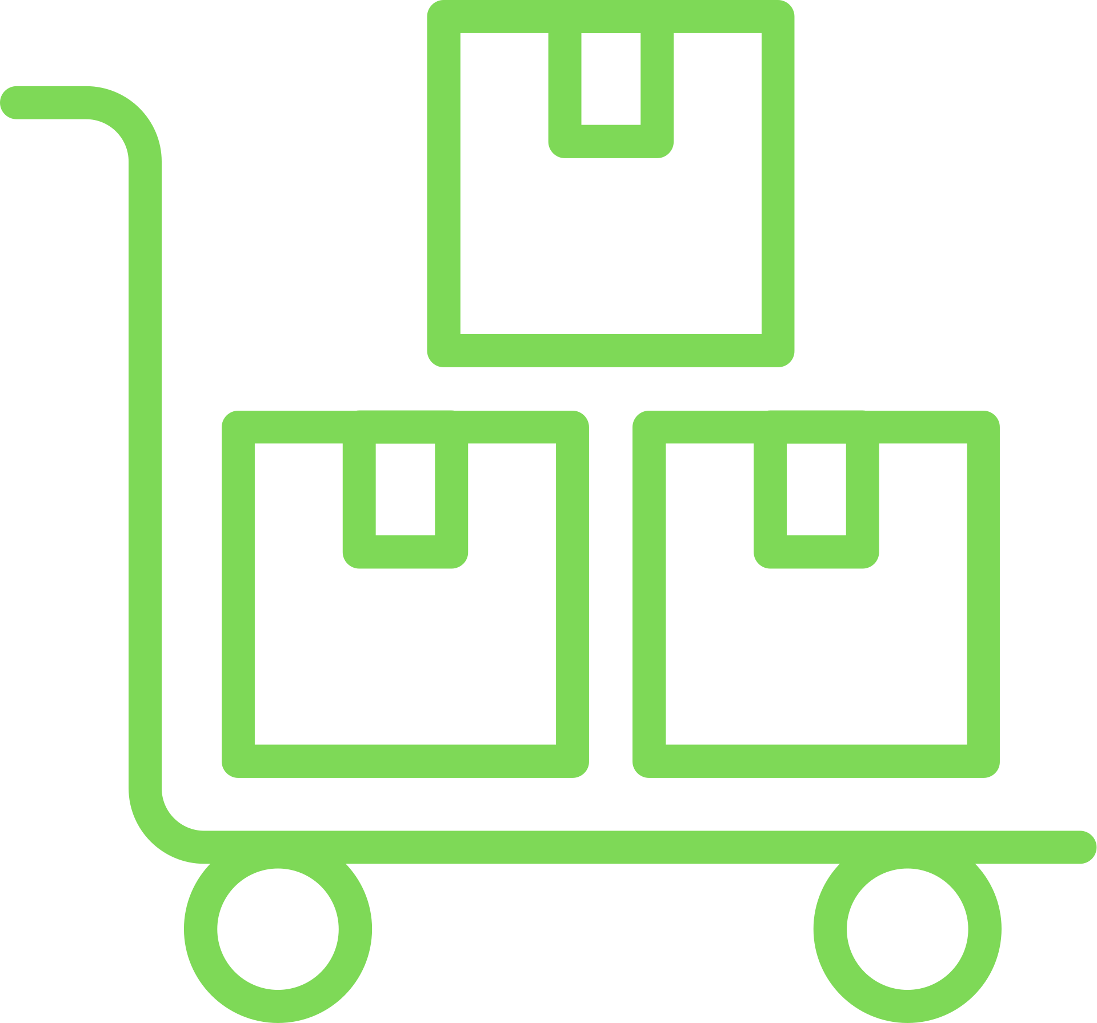
types of distribution
business to consumer (B2C)
business to business
(B2B)
business to business to consumer (B2B2C)
online distribution
wholesale distribution

Slide 12
which model is right?
It depends on the business. Remember to use your customer personas--if you are focused on selling directly to consumers, you are likely using a B2C model
**Your business could have multiple distribution models.

Slide 13
share:
what is your model?
Share your business model with the cohort.
Help brainstorm other models your business could use.

Slide 14
distribution channels

Slide 15
direct distribution
Physical Storefront Location
E-Commerce Websites For Goods & Services
Farmers Markets & Pop-ups
Festivals & Events

Slide 16
indirect distribution
Retail Partnerships
(selling in another store)
Amazon, ETSY, Ebay
Farmers Markets & Pop-ups
Festivals & Events

Slide 17
digital distribution
Software As A Service Platforms
App Stores
Email Marketing
Affiliate Programs
Social Media Commerce

Slide 18
share:
what is your distribution channel?
Share your distribution channel(s) with the cohort.
Help brainstorm other channels your business could use.

Slide 19
business models

Slide 20
what is a business model?
A business model defines how a business creates, delivers, and captures value to generate revenue.

Slide 21

common business models
direct & non-direct sales
renting &
leasing models
brokerage
models
licensing
models
affiliate
model
subscription
models
usage
models
advertising
models
marketplace
model
freemium
model

Slide 22
how do you choose a
business model? (kiss)
KISS (Keep It Simple Startup)
Startups should not have to explain how customers pay them. Make it easy for customers to find and pay for your service.

Slide 23
pricing

Slide 24
under-pricing pitfalls
pricing too low undervalues the solution ⬇️
The goal should not be the cheapest solution. The goal is to offer the best solution and value to the customer at an acceptable price.

Slide 25
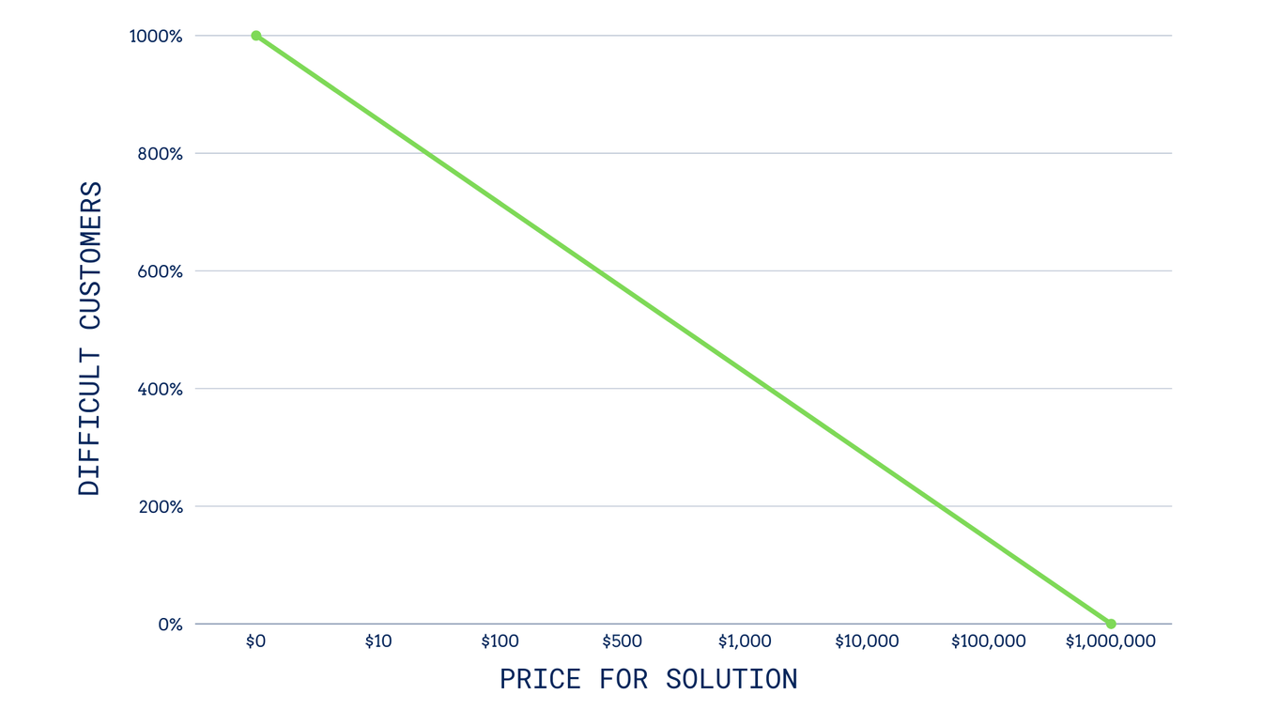
under-pricing pitfalls
cheap products mean difficult customers
⬅️

Slide 26
share:
what is your value?
Is your startup offering a:
premium, standard or cheaper product / service?

Slide 27
share:
how life changing is your offering to customers?
1 2 3 4 5 6
least most

Slide 28

finding your price
Start with the costs to make the product
(or the costs to have it made)
Include your time!
Remember Your Freedom #?
Salary / 2000 = Hourly Rate

Slide 29
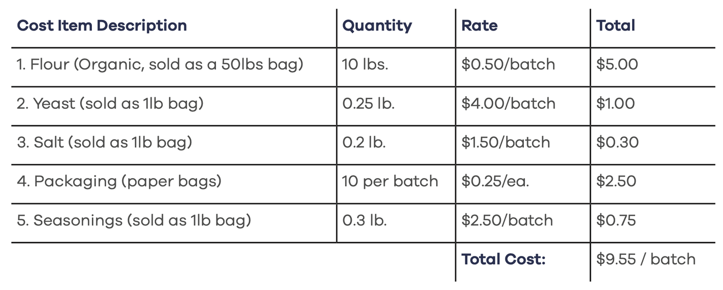
example:
the artisan’s bread bakery
page 88
The total high-level estimate to produce a batch of bread is: $9.55
The Founder’s freedom number is $55,000 per year.
$55,000 / 2,000 hours == $27.50 per hour
It takes 3 hours to bake a large batch: $82.50 per batch

Slide 30
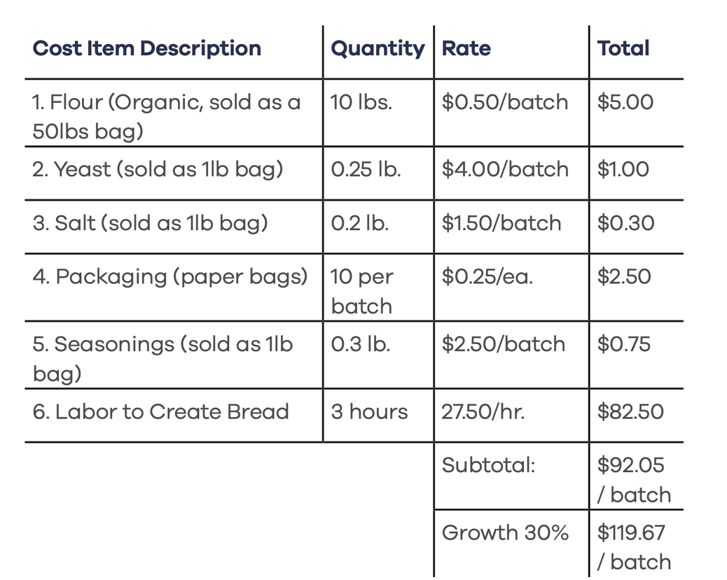
example:
the artisan bread bakery
Factoring in Labor:
The recipe results in 20 loaves of bread per batch.
119.67 / 20 == $5.98 per loaf
This is the minimum price that can be charged with a 30% margin.
Factoring in Labor greatly increases the overall costs. Founders often ignore or forget to add in their time.
page 88
What would you charge?

Slide 31
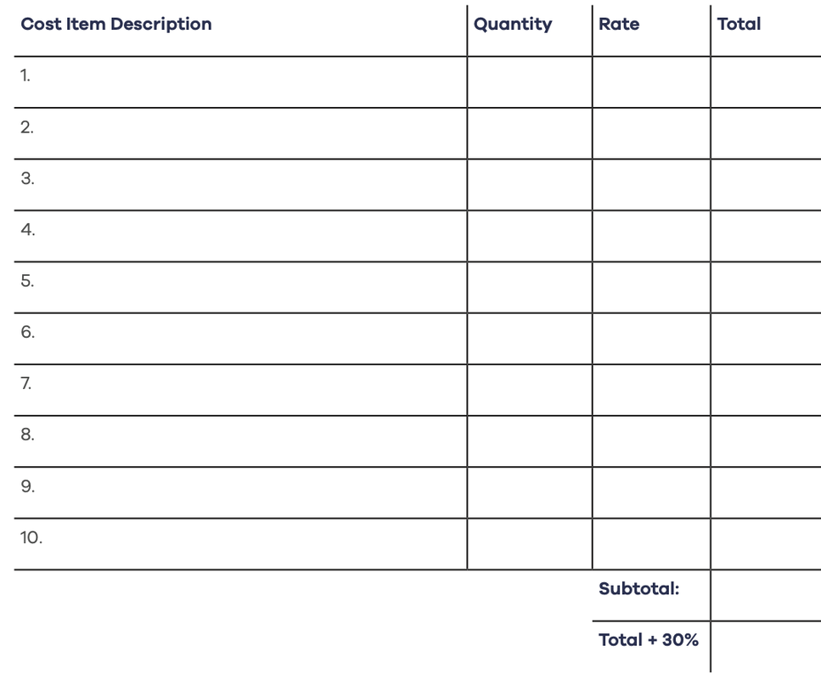
Fill out your cost estimates in your workbook
keep it high-level and remember to add 30% on the end.

Slide 32
finding your pricing
Research what current market rates are in your industry. Talk to potential customers about what prices they pay for similar solutions.
Remember, if you are selling a product, it will be hard to compete with large retailer’s prices.

Slide 33
pricing strategies
cost-plus pricing
value based
pricing
market-entry
pricing
competitive
pricing
subscription
pricing
customer
specific pricing
dynamic
pricing
pay-what-you
want pricing
wholesale
pricing

Slide 34
case study:
Groupon’s Pricing
Groupon started with the market-entry pricing model and offered a huge discount to new customers. Ultimately, this attracted customers that expected big discounts every time, which eroded the value that Groupon’s service provided.

Slide 35
Common pricing strategies
Cost-Plus Pricing
In this strategy, a business adds a fixed percentage or dollar amount to the
total cost of producing a product or service—depending on desired margin.

Slide 36
Common pricing strategies
Value-Based | Premium Pricing
In this pricing strategy, the price is set based on the customers’ perceived value
instead of production costs. Ex. Apple

Slide 37
Common pricing strategies
competitive pricing
This model focuses on setting a price based on one or multiple competitors in the
space. Typically, a Startup chooses to slightly undercut the competition to pull
customers to the new offering.

Slide 38
Common pricing strategies
subscription pricing
In this model, the business charges a monthly fee in exchange for access to the
solution or the delivery of products on a recurring basis. Recurring revenue is king.

Slide 39
case study:
A Positive Subscription
Experience
Make it easy to sign up and cancel the subscriptions
Send reminders before each renewal
Check-in with customers to learn if they are enjoying their experiences with the service.

Slide 40
psychological impacts on pricing
Customer purchasing is influenced by consumers’ own psychology and how a Startup
presents their pricing to its customers.

Slide 41
example: beer study
Low Price vs. Mid Price vs. Expensive Price
This experiment exemplifies the compromise effect (a.k.a. the sandwich effect), where consumers gravitate toward a middle option to avoid extremes.
It also aligns with anchoring, as the presence of higher-priced options can make mid-priced ones feel like a better deal.
Most people avoided the cheapest beer.

Slide 42

share:
let’s pitch
Pitch your business idea to the cohort
in 2 minutes or less.

Slide 43
homework
Interview three customers
Read chapter 4 and fill out workbook
Fill out business model canvas sections

