Slide 1


welcome to
week 2

Slide 2
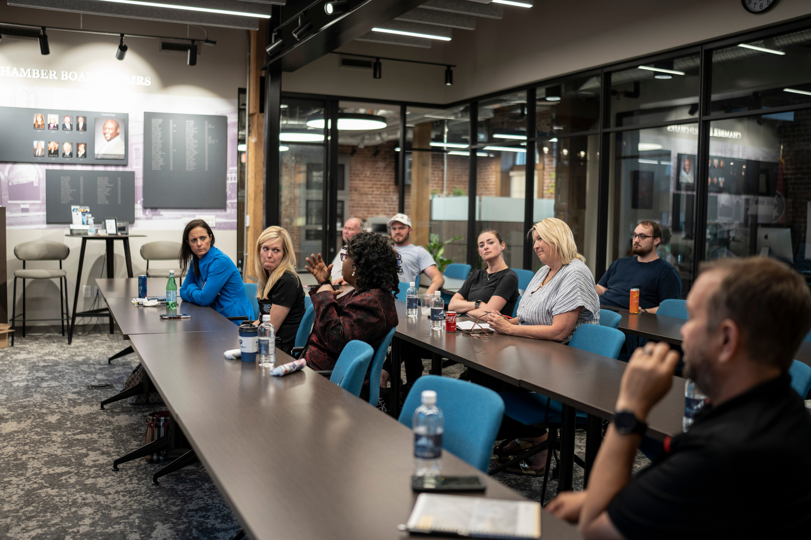

getting to know your customers
learn to identify customers, discover the proper interview process, and gather valuable, unbiased feedback.

Slide 3
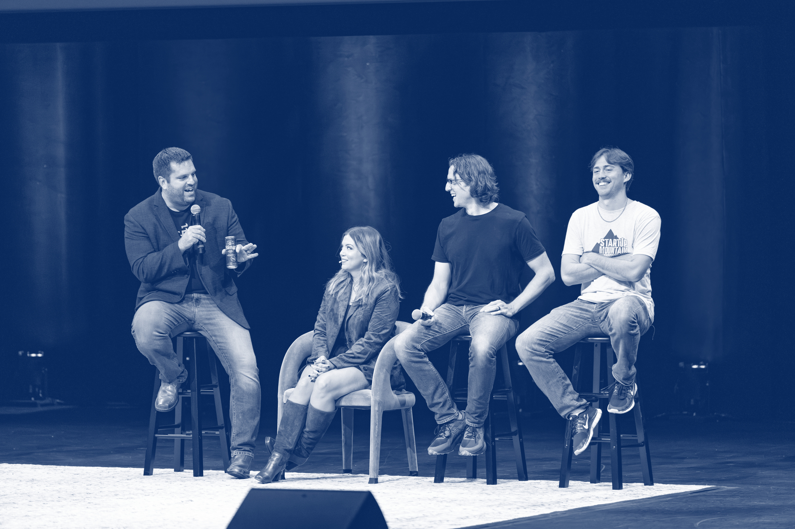
speaker session
(optional)
[Speaker Headshot, Name and Bio]

Slide 4
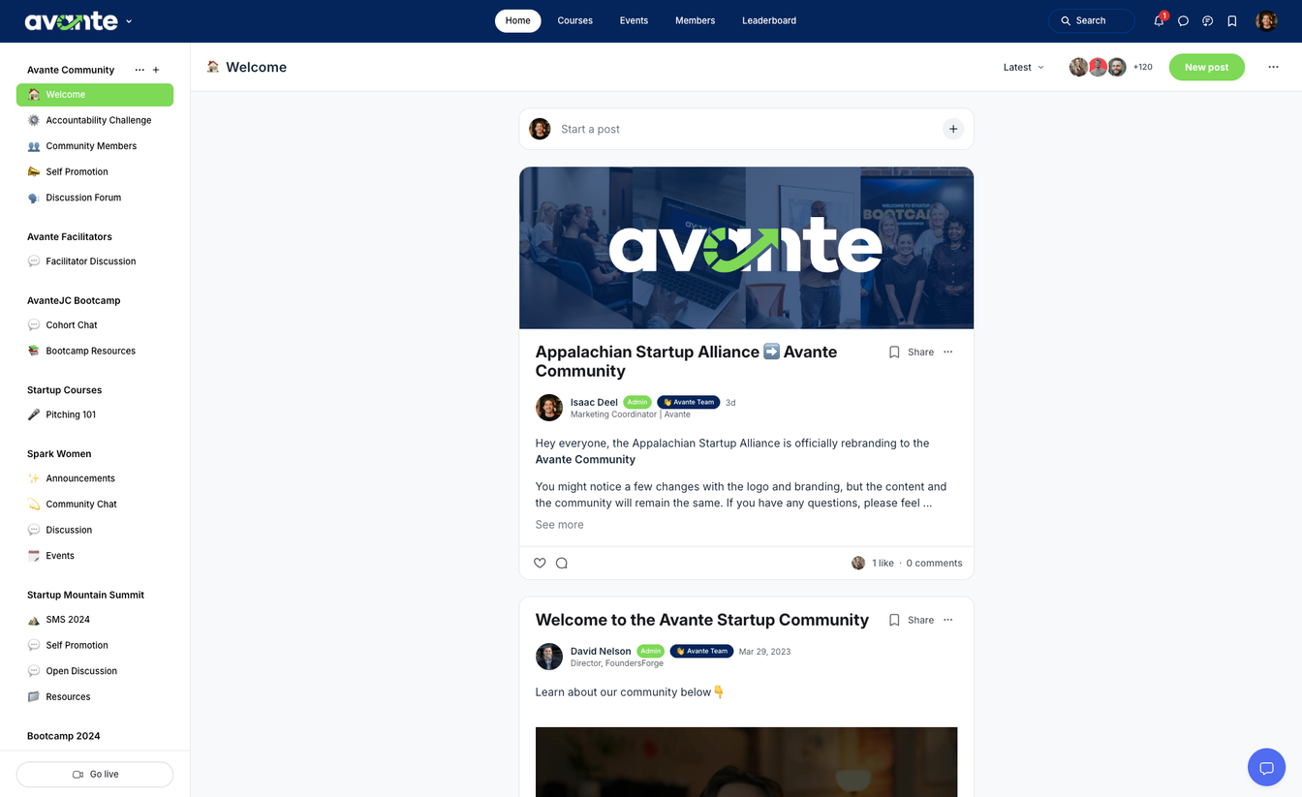

community
Stay updated with your
cohort & facilitator
Learn, connect, and engage with members
Access resources
*scan QR codes in book for access

Slide 5
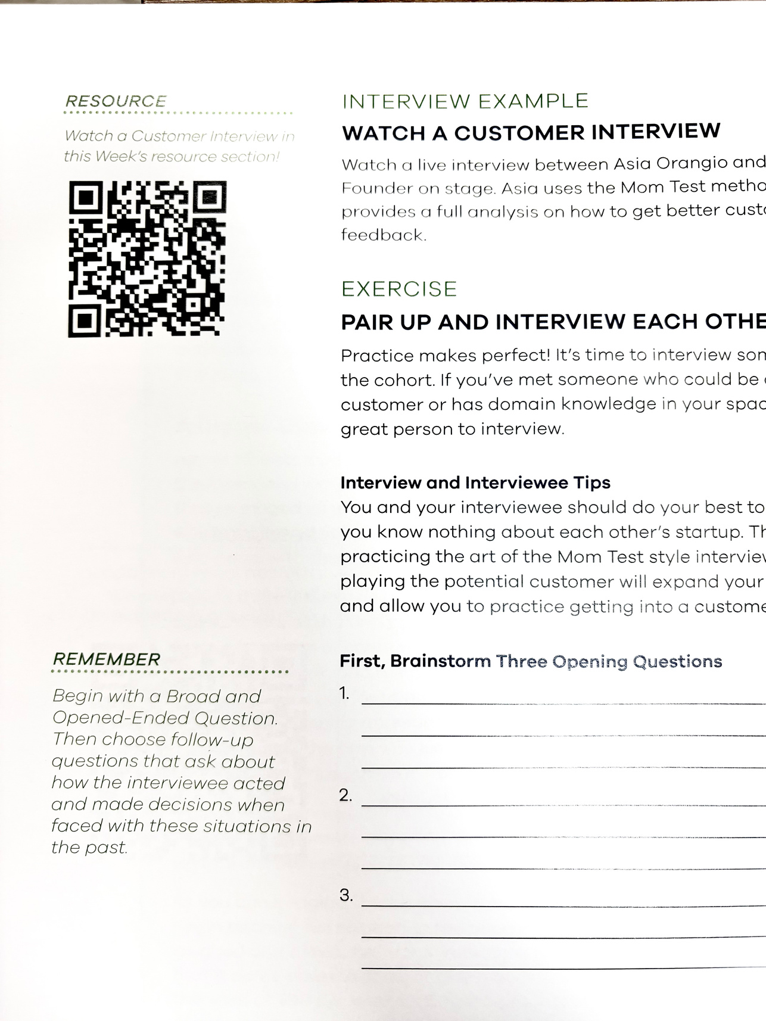
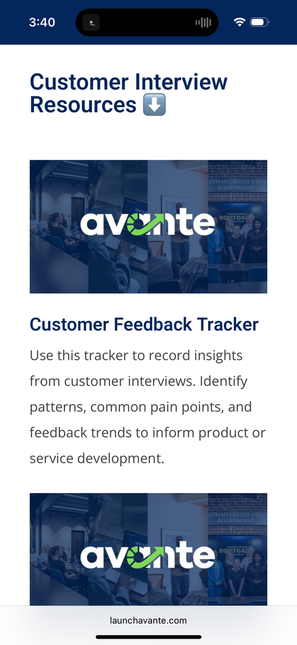
resource library
access chapter resources, interviews, and homework using the QR codes in your avante workbook.
scan

Slide 6
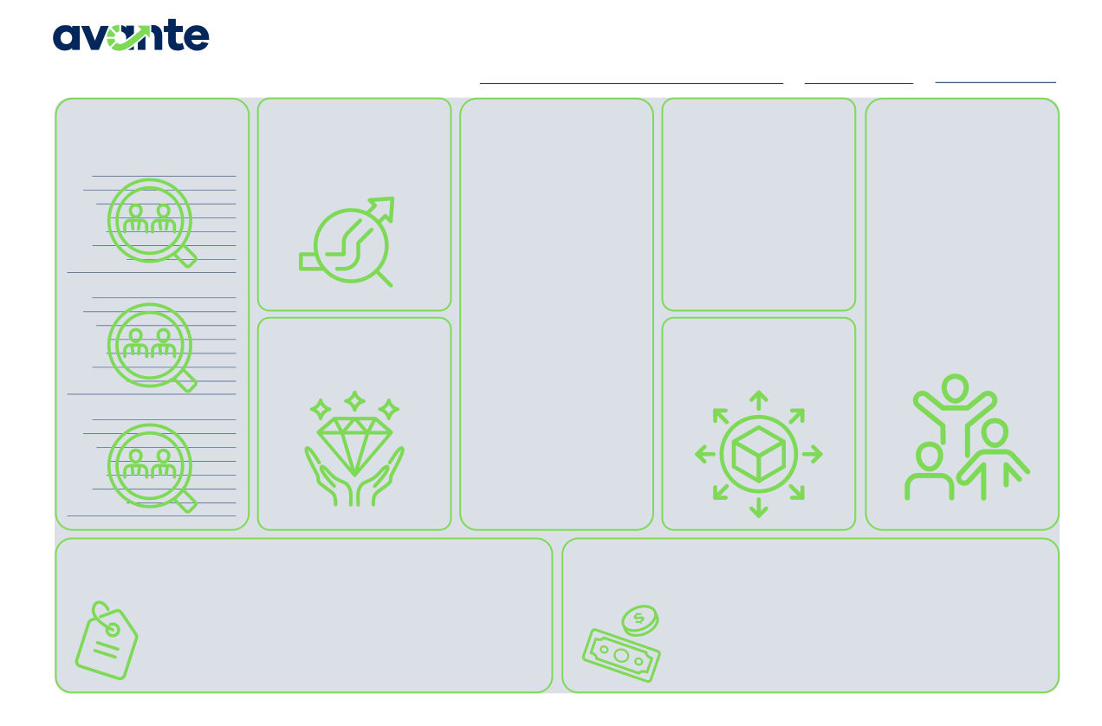
business model canvas
This week, we will fill in the customers section of the canvas.
Business Model Canvas
PROBLEM BEING
Startup Name
Date
Version
CUSTOMERS
List at least 3 of your customer personas or categories of customers
SOLUTION
ALTERNATIVES
How is the customer currently solving the problem? If competition exists, list them in this section.
NETWORK OF
SOLVED
List the problem being solved for your customers. This should be a short and succinct description of the problem.
Describe your Startup’s offering. This should directly solve the problem
SUPPORT
Who in your network will support your business’ success? (i.e. your local Amplify program, SBDCs, local main street program, local entrepreneur centers, friends, family, etc.)
Name Age Gender Pain Points Behaviors Goals How to interact
described.
Name Age Gender Pain Points Behaviors Goals How to interact
VALUE PROVIDED
What is the value to the customer? What do they gain by solving the problem?
DISTRIBUTION
What is the distribution model of the business and what channels exist to get your products to the customer?
Name Age Gender Pain Points Behaviors Goals How to interact
STARTUP COSTS
List the costs or categories of costs your business will require. Don’t forget to include the Founders time!
PRICING STRATEGY AND REVENUE STREAMS
List the primary and alternative pricing strategies. Then list the expected revenue streams for your business.
© 2025 FoundersForge | All Rights Reserved.
The Avante Canvas is adapted from the Business Model Canvas by Strategyzer.com and is licensed under the Creative Commons Attribution Share-Alike 3.0 Unported License.
*scan QR codes in book for digital version

Slide 7

share:
let’s pitch
Pitch your business idea to the cohort
in 2 minutes or less.

Slide 8

share:
victories & roadblocks
Any wins or obstacles you’d like to share with the cohort?
ex. landed my first customer

Slide 9
share:
homework review
Any changes to your problem and solution?
How was the pitch course?
Any challenges or problems with the homework?
Pitch 101 Course

Slide 10
“your most unhappy customers are your greatest source of learning.”
-Bill Gates | Microsoft Co-Founder

Slide 11
product-market fit

Slide 12
product-market fit
Your business must solve an important problem for your customers.
Adoption is needed for growth.

Slide 13

the chasm
The chasm is the divide between early market customers and mainstream market customers
Mainstream Market
THE CHASM
Early Market
THE
INNOVATORS
2.5%
EARLY
ADOPTERS
13.5%
EARLY
MAJORITY
34%
LATE
MAJORITY
34%
THE
LAGGARDS
34%

Slide 14




customer categories
Innovators
Early
Adopters
Early
Majority
Late
Majority
Laggards
Early Market
Mainstream Market

Slide 15
crossing the chasm
How do businesses access the mainstream market?
Have a deep understanding of the customer, their problem, and your solution
Marketing (Paid & Direct)

Slide 16
discussion
linkedIn Case Study
Early customers are unlikely to be a sign of product market fit.
Talking to your customers is important at all stages of your business.

Slide 17


founders are not their own customers
Founders often say, “I know this is a problem worth solving because I have this problem.”
The majority of your customers will have needs and perspectives different from your own.

Slide 18
the simple solution?
Turn your insights into a hypothesis, then ⬇️
Learn as much as you can about the problems your customers are having, how they are currently addressing the problem, and their experience.

Slide 19
customer personas

Slide 20

customer personas
Segmenting customers into personas allows founders to better understand their customers’ needs, behaviors, and motivations.

Slide 21
personas continued...
Stop hyper-focusing on demographics... great personas focus on behaviors:
My customer likes _____
My customer believes _____
My customer does _____
My customer needs _____

Slide 22
persona example
Emily The Event Planner
Demographics:
Age: 28–40
Gender: Female
Income: Moderate to High (75,000-100,000)
Pain Points:
Difficulty finding a cake that matches her child’s party theme.
Limited time to coordinate custom orders amidst a busy schedule.
Concern about balancing cost with high-quality, memorable results.
Behaviors
Plans birthday parties months in advance, researching Pinterest and Instagram for ideas.
Frequently seeks out reviews and recommendations for bakeries.
Values visual appeal and uniqueness over simplicity.
Goals
Create a standout birthday experience for her child and impress her guests.
Save time while ensuring reliable and professional service.
How to Interact
Prefers In-Person Interactions
Relaxed yet attentive tone, offering clear communication about custom orders and pickup/delivery options.
Showcase past projects and customer testimonials on Instagram and on the website.

Slide 23
share your personas:
customer personas
Regular Persona
Negative Persona
Who is your customer?
Who is not your customer?

Slide 24
interviewing customers
& the mom-test

Slide 25

don’t trust your mom
Asking your friends, family, and co-workers for feedback only results in biased information.

Slide 26
why?
Because founders focus on pitching the problem, solution, and creating excitement around the solution, the result comes out biased. Plus your mom doesn’t want to disappoint you.

Slide 27
the mom-test method
Interviewing customers should be simple, and valuable. With the right interview techniques, you can receive valuable feedback from anyone--even your mom.

Slide 28
conducting an interview:
Never talk about your ideas and solutions
Focus on open-ended questions
Avoid arguing or trying to convince (sell)
Work to understand the customer’s problems and current solutions

Slide 29
questions to ask
Bad
Good
Is this a good idea?
Why is it so difficult to handle that problem?
Would you buy this?
I’m building this...
What are you doing to solve that today?

Slide 30
with proper interview technique:
✓ Customers share their deep understanding of the problem being solved
✓ It is much easier to determine if the problem is worth solving
✓ Customers are more likely to share new ideas, problems, and opportunities when they aren’t focused on the validity of a solution
✓ A better relationship is formed

Slide 31
finding customers to interview
Just ask. Use your network to your advantage, or use someone else’s network to your advantage. Don’t be afraid to receive criticism and don’t be afraid to get rejected.

Slide 32
discussion
Qurbie Case Study
By focusing on open-ended questions and being truly curious about his customers’ own experiences, David was able to gain some of the most important information for his solution.

Slide 33

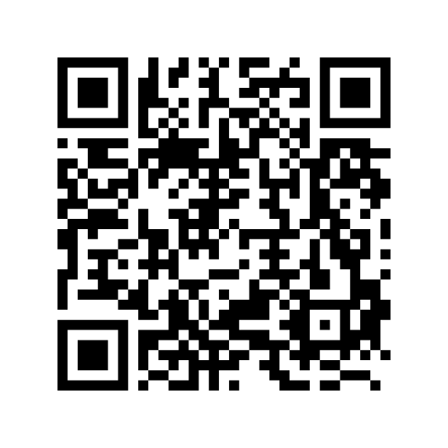
extra resource
interview example video
Watch Asia Orangio complete a customer interview on stage using the Mom-Test method.

Slide 34

exercise
interview each other
Practice the Mom-Test interviewing method with another person in the cohort. Pretend you nothing about their startup.

Slide 35
homework
Build three customer personas to share next week
Interview three customers
Read chapter 3 and fill out workbook

