Slide 1


welcome to
week 1

Slide 2

Hi, i’m Barbara Raymond]
Avante Facilitator
[Optional Bio]

Slide 3

how bootcamp works
Attend class once a week on Monday nights
Read chapter 2 before next Monday
Complete homework before next Monday
Access the community and find additional resources using the QR codes in your book

Slide 4
before we start:
Make sure you received an email link with the pre-work & community link to sign up

Slide 5
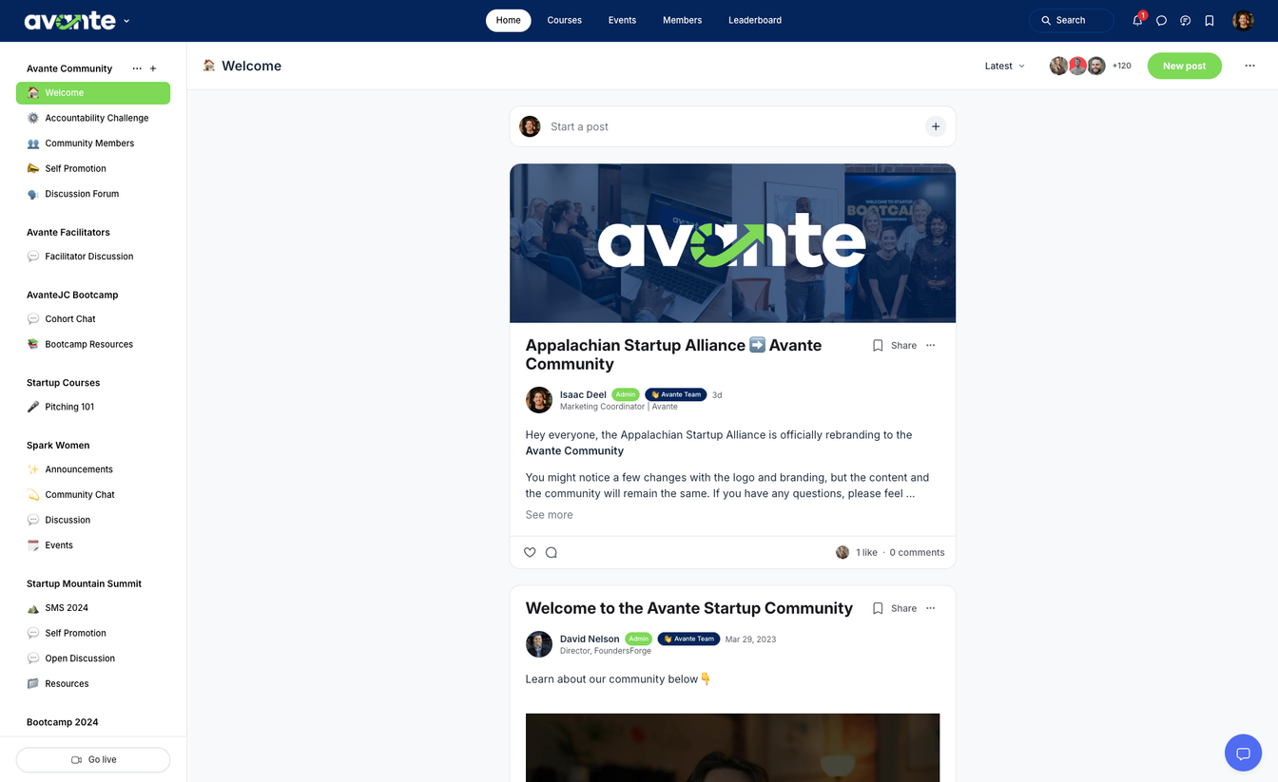
community
Stay updated with your
cohort & facilitator
Learn, connect, and engage with members
Access resources
*scan QR codes in book for access

Slide 6
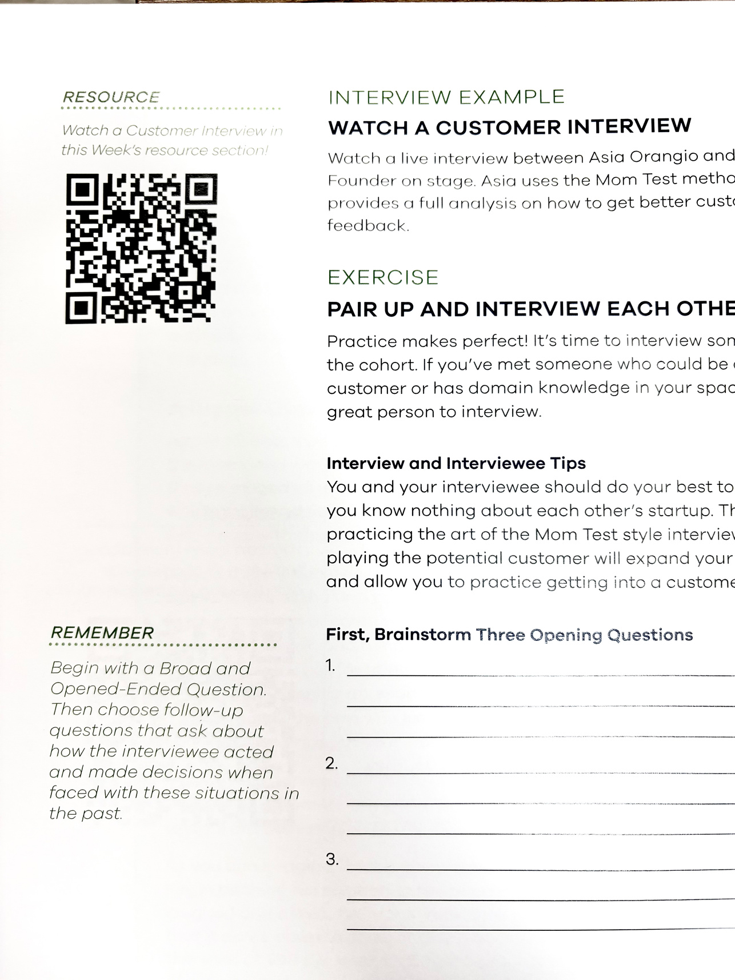
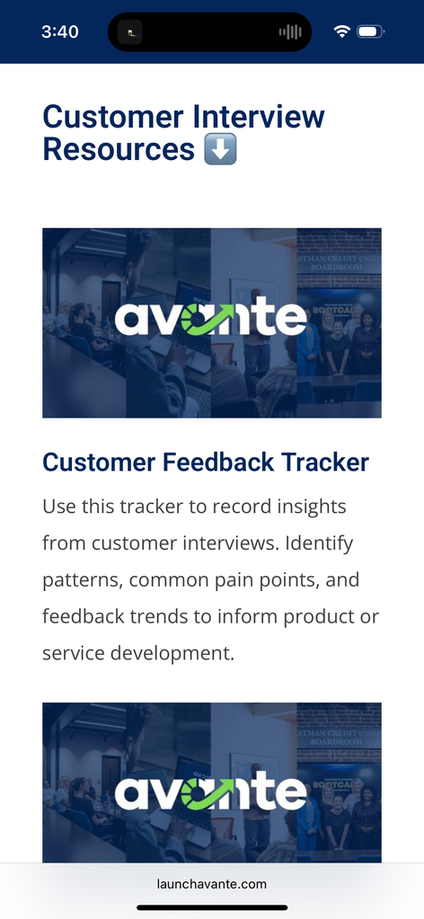
resource library
access chapter resources, interviews, and homework using the QR codes in your avante workbook.
scan

Slide 7

business model canvas
Fill in the business model canvas throughout bootcamp-each week will cover new sections!
Business Model Canvas
PROBLEM BEING
Startup Name
Date
Version
CUSTOMERS
List at least 3 of your customer personas or categories of customers
SOLUTION
ALTERNATIVES
How is the customer currently solving the problem? If competition exists, list them in this section.
NETWORK OF
SOLVED
List the problem being solved for your customers. This should be a short and succinct description of the problem.
Describe your Startup’s offering. This should directly solve the problem
SUPPORT
Who in your network will support your business’ success? (i.e. your local Amplify program, SBDCs, local main street program, local entrepreneur centers, friends, family, etc.)
Name Age Gender Pain Points Behaviors Goals How to interact
described.
Name Age Gender Pain Points Behaviors Goals How to interact
VALUE PROVIDED
What is the value to the customer? What do they gain by solving the problem?
DISTRIBUTION
What is the distribution model of the business and what channels exist to get your products to the customer?
Name Age Gender Pain Points Behaviors Goals How to interact
STARTUP COSTS
List the costs or categories of costs your business will require. Don’t forget to include the Founders time!
PRICING STRATEGY AND REVENUE STREAMS
List the primary and alternative pricing strategies. Then list the expected revenue streams for your business.
© 2025 FoundersForge | All Rights Reserved.
The Avante Canvas is adapted from the Business Model Canvas by Strategyzer.com and is licensed under the Creative Commons Attribution Share-Alike 3.0 Unported License.
*scan QR codes in book for digital version

Slide 8
share:
tell your story
Your story is about you. Share your experiences, your journey, and why you are an entrepreneur. Don’t pitch your business.

Slide 9





types of businesses
service business
agency business
non-profit
small business
high growth

Slide 10


your freedom number
Your freedom number is the amount needed to go full time in your business.
$$$
monthly number
Noah Kagan
AppSumo CEO
$$$
yearly number

Slide 11
define the problem
What is the problem your business is solving?
How will your business make customer’s
lives better?

Slide 12


vitamin or pain reliever?
Vitamin- Your business is an optimal solution to a real/perceived problem
Pain reliever- Your business is an urgent solution to an urgent problem

Slide 13
share in 2 sentences:
my problem & solution
My business is solving this problem
My business is offering this solution

Slide 14
do things that don’t scale
Build your first product yourself
Sell at the farmer’s market
Provide the ultimate customer experience
Give out samples in exchange for feedback

Slide 15

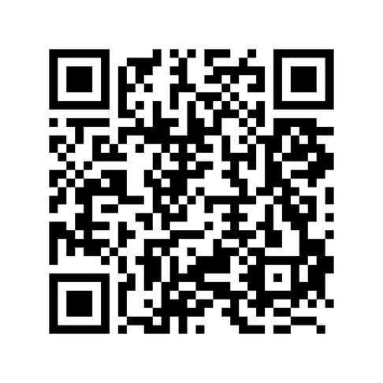
extra resource:
do things that
don’t scale
Matt & Kay
Co-Founders Green Llama

Slide 16
discussion
door dash case study:
How and why did door dash validate their idea?
Why is validation important?

Slide 17

your runway to success
Your runway is the combination of time and money it takes for a founder to get their business up and running.
more money = more time

Slide 18
what to expect
The journey isn’t always easy. Starting a business is rewarding, but challenging.
Be realistic
Give yourself a runway
Don’t be afraid to ask for help

Slide 19
use this program to your advantage
leverage the resources given to you, make new connections, and build something great. Everyone is here to support you..

Slide 20

share:
now, let’s pitch
Pitch your business idea to the cohort
in 2 minutes or less.

Slide 21
“There is no such thing as a million-dollar idea. Just a million-dollar execution.”
-Jeff Hilimire | Co-Founder of Purpose Group

Slide 22

homework
Update the problem & solution you are solving
Complete the pitch training course in the avante community
Read chapter 2 and fill out your workbook

